Slide 1
HSG Process SOP

Slide 2
Table of contents
Introduction to extended functions
PLC function
DEVICE_COLLECT flag introduction
Introduction to substitute material judgment logic
Process Station - CT
AI1 -HSG INPUT
AI2 - INSTALL C-MESH
AI3 - Install C-MESH BKT
AI4 - INSTALL SIM EJECT PISTON
AI5 - INSTALL HOLD BTN&E-CLIP TO HSG
AI6 - INSTALL VOL BTN&E-CLIP TO HSG
AI9 - PASTE & PRESS MIC3 SEAL
AJG - E-clip rework
AI7 - INSTALL RINGER BTN TO HSG
AI8 - INSTALL RINGER&VOLBKT TO HSG
AME - PASTE UAT2 FLEX TO HSG
AIJ - INSTALL HOLD BKT-FAST 3XSCREW
PTI - FASTEN ANT4 2X SCREWS
PH6 - PRESS UAT2 FLEX TO HSG
AIQ - FASTEN UAT2 2X SCREWS
AIT - PASTE MIC3 TO HSG
AJ1 - PRESS MIC3 TO HSG
AJ2 - INSTALL MIC3 COWLING
AIR - PASTE BTN FLEX TO HSG
AIS - PASTE-PRESS MIC4 TO SPK BKT
AIL - INSTALL DIC SPRINGS&PASTE DOCK FLEX
PGY - FASTEN DOCK 3X SCREWS
PH0 - FASTEN 2X ANT SCREWS
AFA - INSTALL SUPERVENT FLEX
PH2 - INSTALL MIC4 TO HSG
PTG - PRESS MIC4 TO HSG
PH4 - INSTALL SPK TO HSG
AZ0 - FASTEN LAT SCREWS & Output

Slide 3
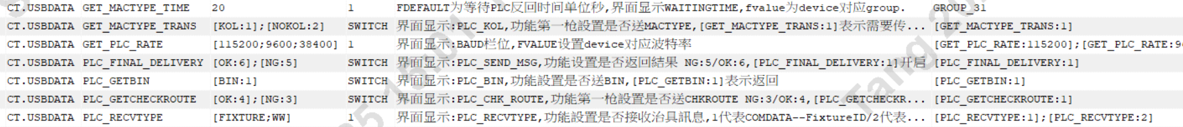
PLC function introduction
PLC Features:
BY GROUP Group settings:
SELECT * FROM AP_INI WHERE APID ='CT.USBDATA' AND FDEFAULT='GROUP_3';
SELECT * FROM AP_INI WHERE APID='CT.USBDATA' AND FNAME IN ('GET_MACTYPE_TIME','GET_MACTYPE_TRANS','GET_PLC_RATE','PLC_FINAL_DELIVERY','PLC_GETBIN','PLC_GETCHECKROUTE','PLC_RECVTYPE')
GET_MACTYPE_TIME: Maintenance PLC return waiting time ( this item needs to be maintained separately by By group , which is the same as the time set in PLC_GROUP )
GET_MACTYPE_TRANS: Function first shot setting whether to send MACTYPE
GET_PLC_RATE: Maintain baud rate
PLC_FINAL_DELIVERY: Whether the function setting returns the result NG:5/OK:6
PLC_GETBIN: Function setting whether to send BIN
PLC_GETCHECKROUTE: Whether the function first shot setting is CHKROUTE NG:3/OK:4
PLC_RECVTYPE: Function setting whether to receive fixture messages
Message transmission frequency : 5 times / second ( 1 round of transmission ) U
Scope of application : CT.USBDATA program

Slide 4
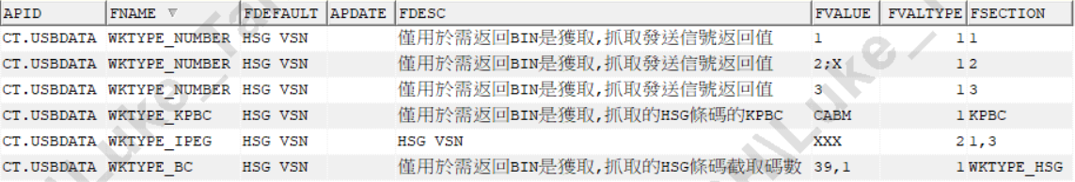
PLC function introduction
2. BY DEVICE settings :
SELECT * FROM AP_INI WHERE APID ='CT.USBDATA' AND FSECTION IN('344158','348015');
MLSET : Set StarFighter Is the WS IP connected to the ML network and connected to the MAC MINI via USB-LAN for taking photos and uploading to the Cambrian server.
PLAY_MUSIC: BY DEVICE maintenance turns on sound prompts
3. Special instructions for setting PLC_GETBIN to obtain BIN :
SELECT * FROM AP_INI WHERE APID ='CT.USBDATA' AND FNAME IN('WKTYPE_NUMBER','WKTYPE_IPEG','WKTYPE_KPBC','WKTYPE_BC');
FNAME = WKTYPE_NUMBER maintains the BIN level corresponding to the intercepted value
FNAME = WKTYPE_KPBC maintenance needs to check the bin 's KPBC
FNAME = WKTYPE_IPEG maintains and captures whether the intercepted value in the VSN barcode corresponding to KPBC conforms to FVALUE. FVALTYPE is BIN level (the priority is higher than the last two maintenance)
FNAME = WKTYPE_BC maintenance needs to obtain the value intercepted from the VSN barcode corresponding to KPBC ( in conjunction with the latter maintenance decision )

Slide 5
DEVICE_COLLECT . SCANFLAG flag introduction
I : ISN flashes DB first, Multi DB mode
R: COPY the DEVINFO of the SID where the ISN is located back to the SID where the DEVICE is located
K : Indicates that the DEVICE is a KP LINK station
N : Indicates that the DEVICE is a second-level KP LINK station
V : BY KPSN to find DB (KPSN must use LINK ISN)
C : means CHK is only performed on KP
S : Represents whether the first 17 codes of KPSN have been LINKed
B : Represents the starting station , requires LINK RFID
E: Represents the end station and needs to delink the LINK RFID
P: stands for display picture
e : means you can swipe PALLET/RFID to pass the station
2 : Represents CHK on the second- order KP
3 : Represents CHK on third- order KP
4 : Represents CHK on fourth-order KP
Scope of application : All CT procedures

Slide 6
Introduction to Alternate material judgment logic
1. If the ITEMR_MAPPING table has a maintenance substitution relationship (this table is not currently used to maintain alternare materials) or the BOM table has a maintenance substitution relationship, or both maintain a substitution relationship, then the match is OK, otherwise it prompts a mismatch .
2. Value-grabbing logic for alternative materials :
SELECT ITEM,SUBITEM FROM ITEMR WHERE (OWNER,ITEM)IN(
SELECT OWNER,ITEM FROM ITEMR WHERE (OWNER,ITEM)IN(SELECT ITEM,SUBITEM FROM BOM WHERE SYSDATE BETWEEN NVL(VDATE,SYSDATE) AND NVL(EDATE,SYSDATE)
START WITH ITEM='%$%' CONNECT BY PRIOR SUBITEM=ITEM)AND ITEM='%$%'
UNION
SELECT OWNER,ITEM FROM ITEMR WHERE (OWNER,ITEM)IN(SELECT ITEM,SUBITEM FROM BOM WHERE SYSDATE BETWEEN NVL(VDATE,SYSDATE) AND NVL(EDATE,SYSDATE)
START WITH ITEM='%$%' CONNECT BY PRIOR SUBITEM=ITEM)AND SUBITEM='%$%')
UNION ALL
SELECT SUBITEM,SUBITEM FROM BOM WHERE SUBITEM='%$%' AND SYSDATE BETWEEN NVL(VDATE,SYSDATE) AND NVL(EDATE,SYSDATE)
START WITH ITEM='%$%' CONNECT BY PRIOR SUBITEM=ITEM
SELECT SUBITEM FROM BOM WHERE ITEM IN(SELECT SUBITEM FROM ITEMR WHERE (OWNER,ITEM)IN(
SELECT ITEM,SUBITEM FROM BOM WHERE SYSDATE BETWEEN NVL(VDATE,SYSDATE) AND NVL(EDATE,SYSDATE)AND CONNECT_BY_ISLEAF=0
START WITH ITEM='%$%' CONNECT BY PRIOR SUBITEM=ITEM))AND SUBITEM='%$%' AND SYSDATE BETWEEN NVL(VDATE,SYSDATE) AND NVL(EDATE,SYSDATE )
Scope of application: All LINK sites and settings are turned on

Slide 7
MOH control checkpoints
1. Card level opening settings :
SELECT * FROM ROUTE@SHKGP1_RPT WHERE ROUTE='KAM1 ';
The level is enabled by default BY ROUTE setting , ROUTE.ROUTEFLAG setting small q, you can close the route and disable the MOH block , also known as the FBD block .
2. Specific checkpoint settings :
SELECT * FROM CHKRULE_D@SHKGP1_RPT WHERE RULETYPE ='CHKFBD_NEW' AND RULEITEM='$KPBC$';
Only LINK KP stations are applicable to this level , including test station LINK.
Two maintenance methods :
① Maintenance according to KPBC, rules
② According to KPBC , rules , Datecode Maintenance (the rule content contains the words [DC,3,4,YIWD] enabled)
RULEITEM sets the KPBC that needs to be blocked
RULESTR sets the rules for KPBC corresponding barcodes
TIMESET sets datecode , the content value is the old version of datecode , the format is YWWD/YWW
RULEFLAG sets two flags F/T , F: Those that comply with the rules cannot be LINK , T: Those that comply with the rules can be LINK

Slide 8
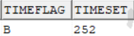
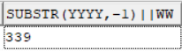
MOH control checkpoints
Maintenance method one Rules and control instructions :
Determine whether the rules are met based on the KPSN barcode brushed in , and then use the RULEFLAG flag to determine whether it is stuck and an error is reported or it can be linked to the station.
Maintenance method two Time management instructions :
The DATECODE setting of TIMESET needs to match the TIMEFLAG field.
TIMESET sets datecode , the content value is the old version of datecode , the format is YWWD/YWW, and only the first 3 codes are intercepted in the background
TIMEFLAG is set with three flags A/B/E to obtain the corresponding datecode .
A:AFTER ,>= datecode of TIMESET value ;
B:BEFORE,<= datecode of TIMESET value ;
E:equire, = datecode of the TIMESET value (this is generally not set).
Determine whether the rule is consistent based on the KPSN barcode brushed in , then determine whether the datecode is consistent , and use the RULEFLAG flag to determine whether it can LINK
PS KANGOL models have started to enable new datecode rules , 34- base algorithm , and a fixed length of 3 codes, so the old and new datecodes will be converted through SQL to unify them.
SELECT SUBSTR(YYYY,-1)||WW FROM YYWEEK WHERE WTYPE='APPLE'AND (SELECT DOMDAY FROM DOM WHERE DOMDAY BETWEEN
SYSDATE-3650 AND SYSDATE+3650 AND DOM=SUBSTR( 'GZA', 1,3))BETWEEN FROMDAY AND ENDDAY;
As follows : new datecode GZA is converted to old datecode 339

Slide 9
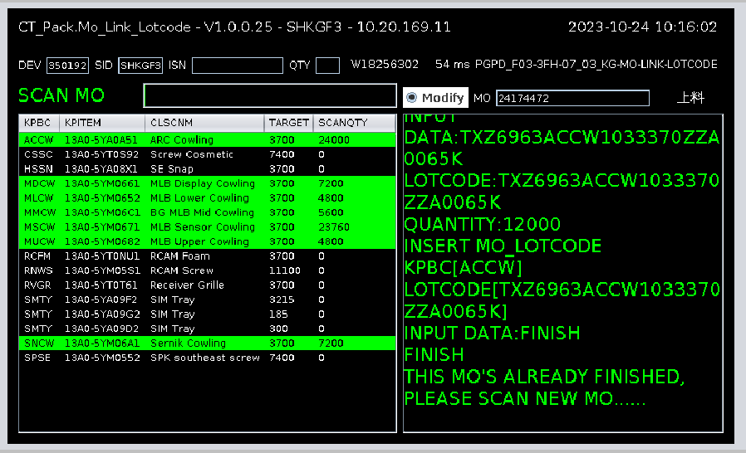
HSG-MO_LINK_LOTCODE- Hand Brush Station
Current site functions :
OFFLINE position
The MO state of the stuck level is the unfolded state.
Bind the work order with LOTCODE ,
MO_LOTCODE table
Block LOTCODE rules
Check the 26th code algorithm ,
LOTCODE_26_CHECK
Limit on the number of single LOTCODEs cleared
Brushing method : MO work order number +KPBC+LOTCODE (KPSN)+FINISH+KPBC+LOTCODE(KPSN)+FINISH.....
WKTYPE : WKS07_PSTEP6
Program name : CT_Pack .Mo_Link_Lotcode

Slide 10
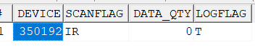
HSG-MO_LINK_LOTCODE- Hand Brush Station
DEVICE configuration information:
SELECT * FROM DEVICE@SHKGF3_RPT WHERE DEVICE='350192';
SELECT * FROM DEVICE_CFG@SHKGF3_RPT WHERE DEVICE='350192';
SELECT * FROM DEVICE_COLLECT WHERE DEVICE='350192'

Slide 11
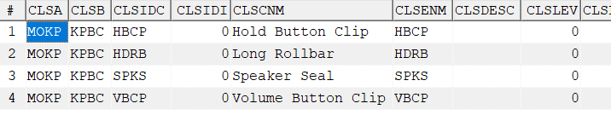
HSG-MO_LINK_LOTCODE- Hand Brush Station
Involving SFIS maintenance:
SELECT * FROM ap_ini @SHKGF3_RPT WHERE apid='MO_LINK_LOTCODE' --used to define which KPBC are called LOTCODE
SELECT * FROM cls @SHKGF3_RPT WHERE clsa='MOKP' AND CLSIDC='%$%';-- Define the ingredient name
CT_PACK.MO_LINK_LOTCODE ' and fname='LOTCODE_26_CHECK'; --- Checking whether the 26th code of the lotcode is correct involves a special algorithm to prevent users from creating barcodes without permission.
SELECT * FROM ap_ini @SHKGF3_RPT WHERE apid='CT_PACK.MO_LINK_LOTCODE' and fname='SCANFILTER'; --Maintain valid characters

Slide 12
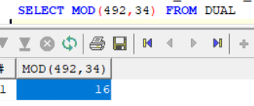
HSG-MO_LINK_LOTCODE- Hand Brush Station
LOTCODE_26_CHECK check level introduction :
26th code below is calculated based on the first 25 codes according to the following algorithm. If the barcode printed privately by the user only meets the rules maintained by ME but does not meet this level, it will also get stuck. (remainder algorithm)

Slide 13
HSG-MO_LINK_LOTCODE- Hand Brush Station
RULETYPE: CHKKP_LOTCODE level introduction :
select * from chkrule_d @SHKGF3_RPT where ruletype='CHKKP_LOTCODE' and ruleitem in ('13A0-5YA08V1','13A0-5YA0AR2','13A0-5YM0552','13A0-5YM05V2');
MODEL is the minimum packaging quantity of the material number Lotcode
for flashing VSN checkpoints must comply with the RULE set by RULESTR .

Slide 14
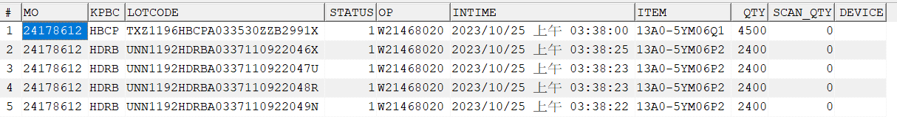
HSG-MO_LINK_LOTCODE- Hand Brush Station
LOTCODE quantity limit:
It is only used to control a single Lotcode . After use , other work orders cannot be entered.
SELECT * FROM MO_LOTCODE@SHKGF3_RPT WHERE lotcode='TXZ1196HBCPA033530ZZB2991X' ;
SELECT * FROM CHKRULE_D @SHKGF3_RPT where RULEITEM='13A0-5YM06Q1';
Logical judgment:
flashing the lotcode kpsn , determine whether the total quantity of SCAN_QTY used by this small material is greater than the minimum packaging quantity corresponding to the model .
If it is greater than the value, an error will be reported: the lotcode is full, please re-enter the new lotcode barcode .
less than then Continue with other logical judgments .

Slide 15
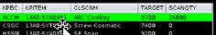
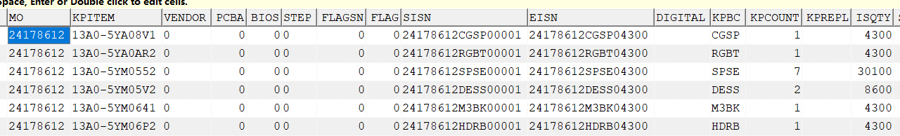
HSG-MO_LINK_LOTCODE- Hand Brush Station
Program interface field algorithm :
TARGET field:
Fetch mokp table ISQTY>0
select kpbc,kpitem,isqty from mokp @SHKGF3_RPT where mo='24178612' and kpbc IN ('HBCP','HDRB','SPKS','VBCP','VLRB','M4MB','DPBR','VTBS ','ESAL','M3MB','RGBT','VLBT','HDBT','CGSP','M3BK','CMSN','SMPT','SPTR','BTNS','DESS', 'SPSE') AND ISQTY>0 ;
SCANQTY field:
select * from CHKRULE_D @SHKGF3_RPT where rueltype='CHKKP_LOTCODE' and RULEITEM='13A0-5YA0AR2';
The KPBC brushes the sum of the minimum packaging quantities of the Lotcode ( grab the model field of the ME maintenance rules , which is the sum of the minimum packaging quantities )

Slide 16
HSG-MO_LINK_LOTCODE- Hand Brush Station
MO status check level:
The work order cannot be entered if it has not been invested .
select mo,status from mo@SHKGF3_RPT where mo='24178612' ;
If MO.STATUS is not 1, an error will be reported: MO status is incorrect, please check!
Instructions involved:
FIRSTPAGE Return to the home page of the program interface
PREVIOUSPAGE returns the previous page of the current page
NEXTPAGE returns the next page of the current page
MODIFY After MO has been put into production, it is found that the number of scanqty is low and LOTCODE needs to be refreshed.

Slide 17
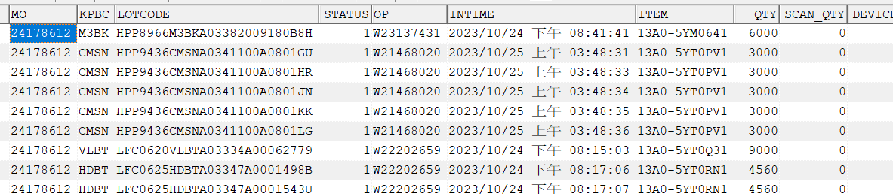
HSG-MO_LINK_LOTCODE- Hand Brush Station
Data storage:
SELECT * FROM MO_LOTCODE@SHKGF3_RPT WHERE mo=' 24178612 '

Slide 18
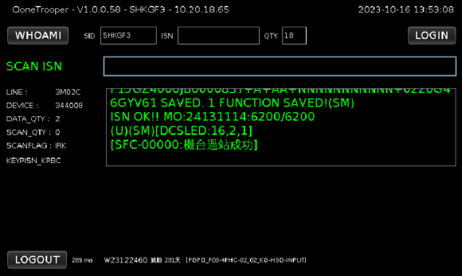
HSG- HSG INPUT - Hand Brush Station
Station name : HSG INPUT
Current site functions :
input station
Substitute materials allowed
MO_KP_CONTROL control
DOUBLE CHECK checkpoint
( compare EEEE)
OFFLINE processing jam
The KP material leaking LINK ?
LINK CABM and PASS ROUTE
Station GRP : AI1
Brushing method : HSG 70ISN+HSG VSN(CABM)
WKTYPE : KEYPISN_KPBC
Program name: CloneTrooper

Slide 19
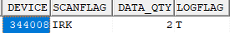
HSG- HSG INPUT - Hand Brush Station
SFIS configuration information :
DEVICE:SELECT * FROM DEVICE WHERE DEVICE='344008'
DEVICE_CFG:SELECT * FROM DEVICE_CFG WHERE DEVICE='344008'
DEVICE_COLLECT:SELECT * FROM DEVICE_COLLECT WHERE DEVICE='344008'
I:ISN first search for DB, Multi DB mode
R: COPY the DEVINFO of the SID where the ISN is located back to the SID where the DEVICE is located
K: means that the DEVICE is a KP LINK station
WKTYPE Description:
KEYPISN_KPBC LINK KP is added to the station (ROUTE_STEP.KP1/KP2 sets KPBC). The KPBC set in the KP1 field must require LINK to pass the station. The KPBC set in KP2 depends on whether the work order MOKP has issued materials. If so, it must LINK can pass the station

Slide 20
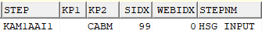
HSG- HSG INPUT - Hand Brush Station
LINK KP and alternative material description :
ROUTE_STEP.KP2 has set up CABM , the work order has issued CABM , and the line body has set up alternative materials. If it conforms to the logic of work order issue or has alternative materials, you can LINK.
SELECT * FROM ROUTE_STEP WHERE STEP='KAM1AAI1'; --This station has set KP2:CABM
select * from mokp where mo='24131114' and kpbc='CABM'; --Query whether the work order has materials issued
select * from CHKRULE_D where RULEITEM='13A0-5YA05G1'; --Query the rules for issuing materials
select * from MODEL_D where MODELID='(UPD_ISN_KP)' AND ATTRNM='3M01C' --Check whether there is a substitute material set

Slide 21
HSG- HSG INPUT - Hand Brush Station
General settings instructions :
1. ROUTE_STEP.STEPFLAG flag K, check whether KP leaks LINK
2. ROUTE_STEP. RTYPE1 sets S and defines the station as an input station.
For input stations:
① After the machine passes the station, ISN.IOSTATUS changes to 1 ( has been invested )
SELECT * FROM ISN WHERE ISN='C7CGZN00D3P00001M6' ;
② After the first machine of the work order passes the station and is put into the station , MO.RSDATE fills in the station passing time , MO.STATUS becomes 2 ( has been put in ) , and each machine passes MO.IQTY+1 until IQTY=TQTY
SELECT * FROM MO WHERE MO='24131114';

Slide 22
HSG- HSG INPUT - Hand Brush Station
Extension function description :
1. MO_KP_CONTROL material control checkpoint
TYPE=5 , subject to FBD checkpoint restrictions ( that is, the kp barcode rules brushed in comply with the rules corresponding to CHKRULE_D.RULETYPE is CHKFBD_NEW , then the error control materials are not allowed to be brushed in )
Multiple VSNs correspond to multiple/ single MOs (but the number of VSNs will be greater than the total number of work orders)
The controlled VSN can only be linked to the corresponding maintenance MO.
The controlled MO can only LINK the corresponding VSN maintained.
2. OFFLINE processing station stuck
AP_INI.FNAME=OFFLINE_CONTROL . LINK KP maintains this setting . It will check whether the KP OFFLINE processing station is completed , that is, whether the KP 's KPSN_TRACK.STATUS is 2. If it is not 2 , it means that the OFFLINE processing station has not been completed. An error message will be reported
SELECT * FROM AP_INI WHERE APID='CHK_KPSN_OC';
FSECTION: There are two types of maintenance , one is fixed to SP , which takes effect on all lines by default , and the other is maintenance line body, which only takes effect on the maintained line body and its priority is higher than the fixed SP.

Slide 23
HSG- HSG INPUT - Hand Brush Station
Extension function description :
3.DOUBLE CHECK checkpoints ( compared to EEEE ) are as follows :
SELECT * FROM AP_INI WHERE APID='MFITEM_MAP' AND FNAME='KPITEM/EEEE' AND FSECTION='KPBC';
This setting is the DOUBLE CHECK master switch .
SELECT * FROM ITEM_FEATURE WHERE FEATUREID='MFITEM_MAP' AND FEATURENM='CABM' AND ITEM_TYPE='EEEE';
ITEM: Maintain HSG 70ISN material number
FEATUREID: fixed to MFITEM_MAP
FEATURENM: Maintain KPBC
FEATUREVALUE: Material rules
ITEM_TYPE: Fixed EEEE
The kp of the link is maintained in AP_INI.APID ='MFITEM_MAP',
Then the corresponding material number of HSG 70ISN must be maintained in ITEM_FEAURE. FEATUREID='MFITEM_MAP' ,
the kp entered through the checkpoint meets the maintenance rules can the link be linked .

Slide 24
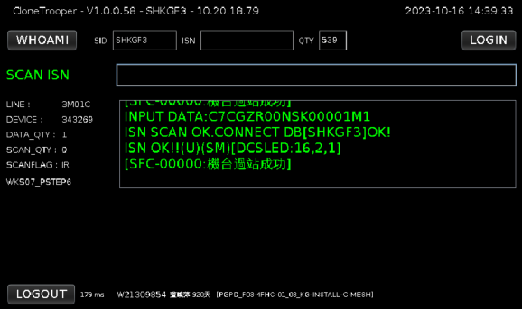
HSG -INSTALL C-MESH -Hand brush station
Station name : INSTALL C-MESH
Current site functions :
Small material leakage and swiping stuck
Upload ISN and bind relationship with small material
ROUTING CONTROL stuck
CHK ROUTE passing station
Station GRP : AI2
Brushing method : HSG 70ISN
WKTYPE : WKS07_PSTEP6
Program name: CloneTrooper

Slide 25
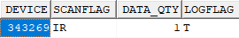
HSG -INSTALL C-MESH -Hand brush station
SFIS configuration information:
DEVICE:SELECT * FROM DEVICE WHERE DEVICE='343269'
DEVICE_CFG:SELECT * FROM DEVICE_CFG WHERE DEVICE='343269'
DEVICE_COLLECT:SELECT * FROM DEVICE_COLLECT WHERE DEVICE='343269'
I:ISN first search for DB, Multi DB mode
R: COPY the DEVINFO of the SID where the ISN is located back to the SID where the DEVICE is located

Slide 26
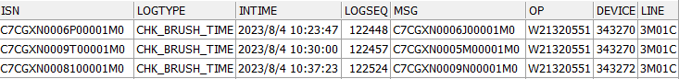
HSG -INSTALL C-MESH -Hand brush station
Common functions :
ROUTE_STEP_CHECK checkpoint description :
SELECT * FROM ROUTE_STEP_CHECK WHERE STEP= 'KAM1AAI2'
Card level 1: Card level of the previous test station KAM1TUPC (PASTE MW & PMU FOAM) PASS record
Checkpoint 2: The difference between the time when the current DEVICE is flashed into the ISN and the previous ISN transit time must be greater than the maintenance time PDATA1 ( 20 seconds)
If it is less than the value, an error will be reported and stored in LOG_ISN.

Slide 27
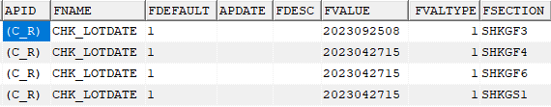
HSG -INSTALL C-MESH -Hand brush station
Extension function description :
Small material card level :
1. First look at ROUTE_STEP setting 5 flags
SELECT * FROM ROUTE_STEP WHERE STEPFLAG LIKE '%5%'
STEPFALG sets the flag 5 , then the gate is turned on. ROMITKP maintains the KPBC that needs to gate small materials . After passing the station, ISN_PARTS adds the binding record of ISN and small materials.
2. Look at the time setting again
SELECT * FROM AP_INI WHERE APID='(C_R)'AND FNAME='CHK_LOTDATE' ;
BY DB maintains a time . The logic is to check whether MO.RSDATE is greater than or equal to AP_INI.FVALUE time . If it is greater than or equal to the AP_INI.FVALUE time, it will check whether MO_LOTCODE has brushed small materials. If it is less than it, it will not be stuck.

Slide 28
HSG -INSTALL C-MESH -Hand brush station
Small material card level :
3.SELECT * FROM AP_INI WHERE APID ='CHECK_ROUTE_LOTCODE' AND FSECTION='KAM1';
Maintaining KOL/NOKOL by BY ROUTE requires blocking the KPBC of small materials , which has a higher priority than the KPBC maintained by ROUTE_STEP.ROMITKP
4. SELECT * FROM AP_INI WHERE APID='MO_LINK_LOTCODE' ;
FVALUE defines which KPBC are small materials

Slide 29
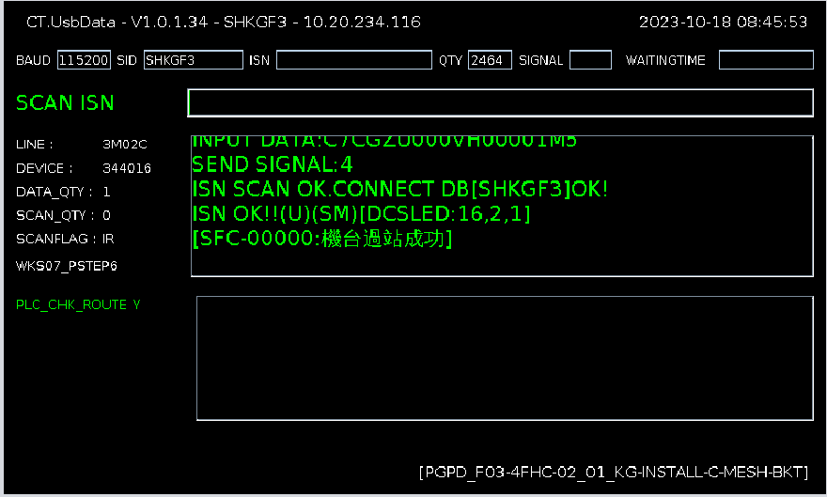
HSG-INSTALL C-MESH BKT- hand brush station
Station name : INSTALL C-MESH BKT
Current site functions :
PLC communication station
Upload FIXTURE ID, COMDATA table
ROUTING CONTROL卡关
CHK ROUTE过站
Station GRP : AI3
Brushing method : HSG 70ISN
WKTYPE : WKS07_PSTEP6
Program name : CT.UsbData

Slide 30
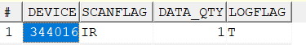
HSG-INSTALL C-MESH BKT- hand brush station
DEVICE configuration information:
SELECT * FROM DEVICE@SHKGP1_RPT WHERE GRP='AI3' AND LINE='3M02C'
SELECT * FROM DEVICE_CFG@SHKGP1_RPT WHERE DEVICE IN ('344016')
SELECT * FROM DEVICE_COLLECT WHERE DEVICE='344016'
I: Find DB by flashing ISN , multi- DB mode
R: COPY the DEVINFO of the SID where the ISN is located back to the SID where the DEVICE is located

Slide 31
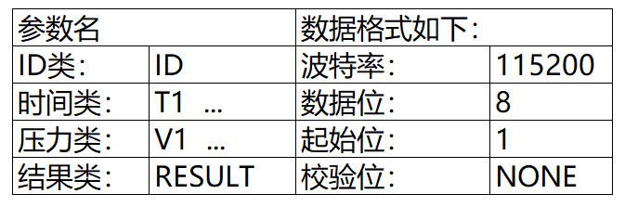
HSG-INSTALL C-MESH BKT- hand brush station
Maintenance involved:
select * FROM AP_INI@SHKGP1_RPT WHERE FVALUE LIKE'%344016%';
select * FROM AP_INI@SHKGP1_RPT WHERE FDEFAULT='GROUP_12';
This station involves two functions:
1 : [GET_PLC_RATE:115200] :
Corresponding to the BUAD field of the program interface, the baud rate is 115200 .
PLC involves communication protocols:

Slide 32
HSG-INSTALL C-MESH BKT- hand brush station
2 : [PLC_GETCHECKROUTE:1] :
The interface displays: PLC_CHK_ROUTE, whether to send CHKROUTE in the first shot setting NG:3/OK:4
PLC_GETCHECKROUTE transmission method:
TIME: 1 second
Times: 5 times
LOG: INFO : INPUT DATA:C7CGZV004FF00001M8
Oct 19, 2023 8:03:47 PM pega.sfis.Form.UsbData sendRequest
INFO: sendRequest:4
Oct 19, 2023 8:03:47 PM pega.sfis.Form.UsbData sendRequest
INFO: sendRequest:4
Oct 19, 2023 8:03:47 PM pega.sfis.Form.UsbData sendRequest
INFO: sendRequest:4
Oct 19, 2023 8:03:47 PM pega.sfis.Form.UsbData sendRequest
INFO: sendRequest:4
Oct 19, 2023 8:03:47 PM pega.sfis.Form.UsbData sendRequest
INFO: sendRequest:4

Slide 33
HSG-INSTALL C-MESH BKT-手刷站
ROUTING CONTROL :
SELECT * FROM ROUTE_STEP_CHECK@SHKGP1_RPT WHERE STEP='KAM1AAI3';
Cooperate with Wktype : WKS07_PSTEP6 to check whether the AI2 pass is passed, and whether there is an error when the machine is stuck . The hand brush station will not be recalculated for the reflow machine UOP .
MO_D stop information :
select * FROM MO_D WHERE ISN ='C7CGZW0006V00001M9';

Slide 34
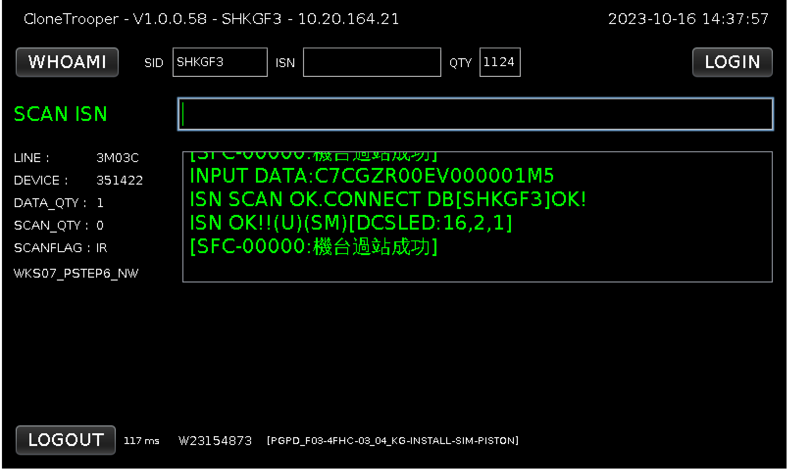
HSG-INSTALL SIM EJECT PISTON- hand brush station
Station name : INSTALL SIM EJECT PISTON
Current site functions :
Distinguish between K/NK machines
ROUTING CONTROL stuck
CHK ROUTE passing station
Station GRP : AI4 _
Brushing method : Scan 70ISN
WKTYPE : WKS07_PSTEP6_NW
Program name: CloneTrooper

Slide 35
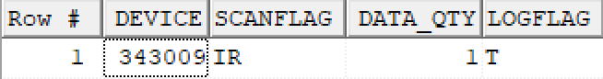
HSG-INSTALL SIM EJECT PISTON- hand brush station
DEVICE configuration information:
DEVICE: SELECT * FROM DEVICE WHERE DEVICE='343009'
DEVICE_CFG:SELECT * FROM DEVICE_CFG WHERE DEVICE='343009'
DEVICE_COLLECT:SELECT * FROM DEVICE_COLLECT WHERE DEVICE='343009'
Flag function:
I: ISN flashes the DB first, Multi DB mode
R: COPY the DEVINFO of the SID where the ISN is located back to the SID where the DEVICE is located

Slide 36
HSG-INSTALL SIM EJECT PISTON- hand brush station
Function Description :
WKS07_PSTEP6_NW description:
Add judgment based on WKS07_PSTEP6 and cooperate with routing control checkpoint to check KOL&NOKOL machine process
Judgment logic :
I SN's MACTYPE=ITEM_IBQ_CUST.MACTYPE
KOL and NOKOL machine determination source -ITEM field maintenance MACTYPE,
If the machine 's MACTYPE matches, it will directly run the checkpoint that matches the setting . If it does not match, the default ITEM setting will be empty .
SELECT*FROM ISN WHERE ISN='C7CGZS0028300001M5'
SELECT*FROM ITEM_IBQ_CUST WHERE ITEM='70A05Y1X1020'
SELECT * FROM ROUTE_STEP_CHECK WHERE STEP='KAM1A AI4 '

Slide 37
HSG-INSTALL SIM EJECT PISTON- hand brush station
ROUTING CONTROL:
SELECT * FROM ROUTE_STEP_CHECK WHERE STEP='KAM1A AI4 '
1. Cooperate with WKTYPE to check the KOL&NOKOL machine process
2. Set the pass record of KAM1A AI3 station and pass in order
Data changes :
SELECT*FROM MO_D WHERE ISN='C7CGZS0028300001M5'

Slide 38
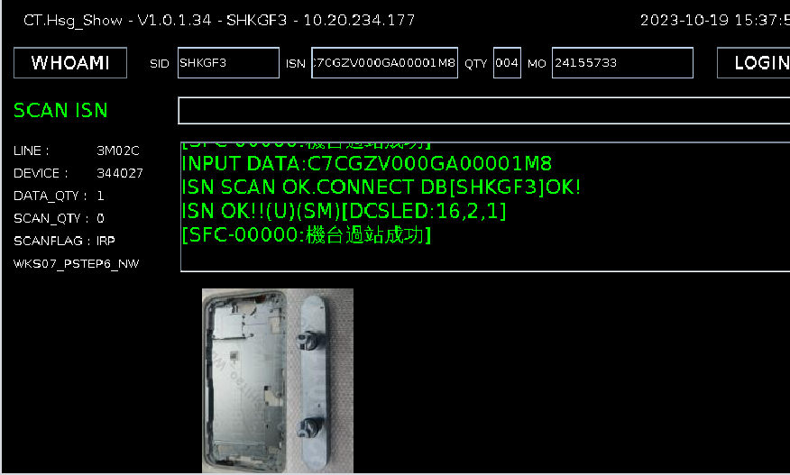
HSG-INSTALL HOLD BTN&E-CLIP TO HSG -Hand Brush Station
Station name : INSTALL HOLD BTN&E-CLIP TO HSG
Station function :
Distinguish between K/NK machines
display image
Sound prompt
ROUTING CONTROL stuck
CHK ROUTE passing station
Station : AI5 _
Brushing method : Scan ISN
Program name : CT.HSG_SHOW
WKTYPE : WKS07_PSTEP6_NW

Slide 39
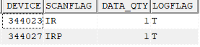
HSG-INSTALL HOLD BTN&E-CLIP TO HSG- Hand Brush Station
DEVICE related settings
SELECT * FROM DEVICE_CFG WHERE DEVICE in ('344023','344027')
SELECT * FROM DEVICE WHERE DEVICE in ('344023','344027')
SELECT * FROM DEVICE__COLLECT WHERE device in ('344023','344027')
flag function
I: ISN first search for DB , Multi DB mode
R: Change the DEVINFO of the SID where the ISN is located COPY back to the SID where DEVICE is located
P: SHOW pictures

Slide 40
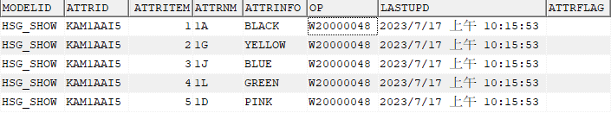
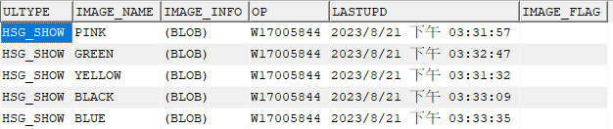
HSG-INSTALL HOLD BTN&E-CLIP TO HSG- Hand Brush Station
SFIS configuration information
Set the HSG_SHOW station show image and match the P flag .
SELECT * FROM R2D2_ROUTE_STEP WHERE ultype='HSG_SHOW'
The corresponding relationship between color codes and colors is maintained by step .
SELECT ATTRNM,ATTRINFO FROM MODEL_D WHERE modelid ='HSG_SHOW' and attrid ='KAM1AAI5'
Picture information maintenance
SELECT * FROM OQC_IMAGE_UPLOAD@SHKGP1_RPT WHERE ultype ='HSG_SHOW'; -- IE personnel maintenance
Image color capture logic :
the P flag is set , set ULTYPE in R2D2_ROUTE_STEP , capture the characters between the first slash and the second slash in the color capture MO.MFMODEL field , and capture the corresponding station in MODEL_D Position color MODEL_D.ATTRINFO , after grabbing the corresponding station color, grab the HSG_SHOW image corresponding to the same color in OQC_IMAGE_UPLOAD.

Slide 41
HSG-INSTALL HOLD BTN&E-CLIP TO HSG- Hand Brush Station
SHOW sound settings :
SELECT * FROM AP_INI WHERE apid ='CT.HSG_SHOW' AND fname ='PLAY_MUSIC'
By device maintains whether to turn on the sound prompt . The sound file exists on the server and needs to be added by the developer .
ROUTING CONTROL
SELECT * FROM ROUTE_STEP_CHECK WHERE STEP='KAM1AAI5'
WKTYPE : WKS07_PSTEP6_NW Determine the KOL/NOKOL machine by checking the material number of the machine in the ITEM_IBQ_CUST.MACTYPE field, and then cooperate with the routing control card KOL&NOKOL to go through the machine process .

Slide 42
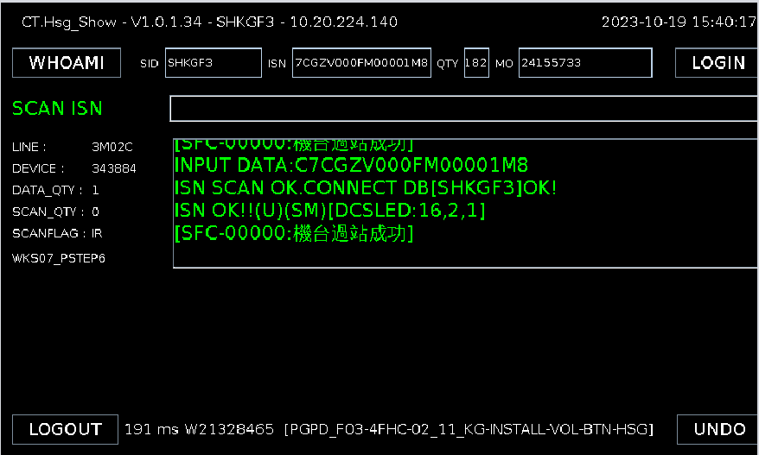
HSG-INSTALL VOL BTN&E-CLIP TO HSG -Hand Brush Station
Station name : INSTALL HOLD BTN&E-CLIP TO HSG
Station function :
Sound prompt
ROUTING CONTROL stuck
CHK ROUTE passing station
Station : AI6 ;
Brushing method : Scan 70ISN;
Program name : CT.HSG_SHOW
WKTYPE : WKS07_PSTEP6

Slide 43
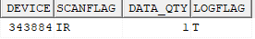
HSG-INSTALL VOL BTN&E-CLIP TO HSG -Hand Brush Station
DEVICE related settings
DEVICE__CFG:SELECT * FROM DEVICE_CFG WHERE DEVICE='343884'
DEVICE: SELECT * FROM DEVICE WHERE device='343884'
Device_Collect:SELECT * FROM DEVICE_Collect WHERE device='343884'
flag function
I: ISN first search for DB , Multi DB mode
R: Change the DEVINFO of the SID where the ISN is located COPY back to the SID where DEVICE is located

Slide 44
HSG-INSTALL HOLD BTN&E-CLIP TO HSG- Hand Brush Station
SHOW sound settings :
By device maintains whether to turn on the sound prompt . The sound file exists on the server and needs to be added by the developer .
SELECT * FROM AP_INI WHERE apid='CT.HSG_SHOW' AND fname='PLAY_MUSIC'
ROUTING CONTROL
SELECT * FROM ROUTE_STEP_CHECK@SHKGP1_RPT WHERE STEP = 'KAM1AAI6';
Cooperate with WKTYPE WKS07_PSTEP6 to check whether the set PDATA station passes in SEQ order and check error

Slide 45
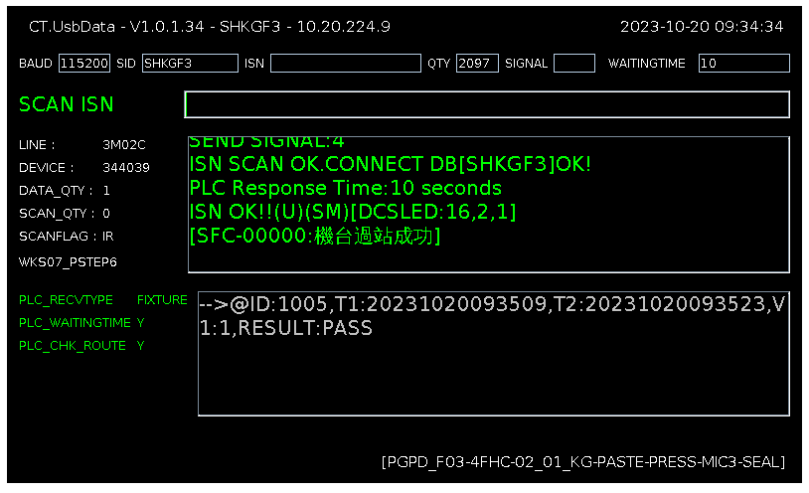
PASTE & PRESS MIC3 SEAL- hand brushing station
Station name : PASTE & PRESS MIC3 SEAL
Current site functions :
PLC communication station
Upload FIXTURE ID, COMDATA table
ROUTING CONTROL stuck
CHK ROUTE passing station
Station GRP : AI9
Brushing method : HSG 70ISN
WKTYPE : WKS07_PSTEP6
Program name : CT.UsbData

Slide 46
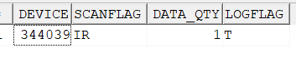
PASTE & PRESS MIC3 SEAL- hand brushing station
DEVICE configuration information:
SELECT * FROM DEVICE@SHKGP1_RPT WHERE GRP='AI9' AND LINE='3M02C'
DEVICE_CFG:SELECT * FROM DEVICE_CFG@SHKGP1_RPT WHERE DEVICE IN ('344039')
DEVICE_COLLECT:SELECT * FROM DEVICE_COLLECT WHERE DEVICE='344039'
I: Find DB by flashing ISN , multi- DB mode
R: COPY the DEVINFO of the SID where the ISN is located back to the SID where the DEVICE is located

Slide 47
PASTE & PRESS MIC3 SEAL- hand brushing station
Maintenance involved:
select * FROM AP_INI@SHKGP1_RPT WHERE FVALUE LIKE'%344039%';
select * FROM AP_INI@SHKGP1_RPT WHERE FDEFAULT='GROUP_1 3 ';
select * FROM AP_INI@SHKGP1_RPT WHERE FVALUE='GROUP_ 1 3 ' ; -The waiting time is maintained separately by the BY group. If not maintained, the default is 120s

Slide 48
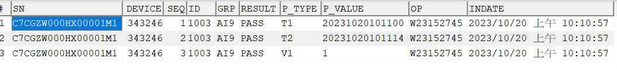
PASTE & PRESS MIC3 SEAL- hand brushing station
This station involves four functions:
1 : [GET_PLC_RATE:115200] : Corresponds to the BUAD field of the program interface , the baud rate is 115200 .
2 : [PLC_GETCHECKROUTE:1] : Interface display : PLC_CHK_ROUTE, first shot setting whether to send CHKROUTE NG:3/OK:4
Log: INFO : INPUT DATA:C7CGZV004FF00001M8
Oct 19, 2023 8:03:47 PM pega.sfis.Form.UsbData sendRequest
INFO: sendRequest:4
3 : [PLC_RECVTYPE:1] : The interface displays : PLC_RECVTYPE , receiving FIXTUREID pressure value.
@ID : 1005,T1:20231019203625,T2:20231019203639,V1:1, RESULT: PASS
4 : [GET_MACTYPE_TIME:10] : It represents the waiting time of 10s . If this time is exceeded, the program will report an error.
NO PLC-SIGNAL BE RETURNED!
COMDATA data storage : DB where ISN is located
SELECT * FROM COMDATA WHERE SN='C7CGZW000F900001M1';

Slide 49
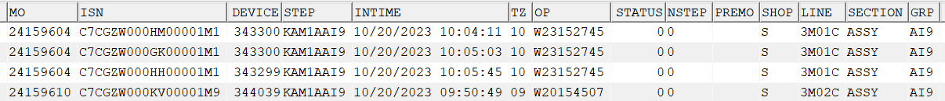
PASTE & PRESS MIC3 SEAL- hand brushing station
ROUTING CONTROL:
SELECT * FROM ROUTE_STEP_CHECK@SHKGP1_RPT WHERE STEP='KAM1AAI9';
Cooperate with Wktype : WKS07_PSTEP6 to check whether the AI6 pass is passed, and whether there is an error when the machine is stuck . The hand brush station will not be recalculated for the reflow machine UOP .
MO_D stop information :
SELECT * FROM MO_D WHERE ISN='C7CGZW000F900001M1';

Slide 50
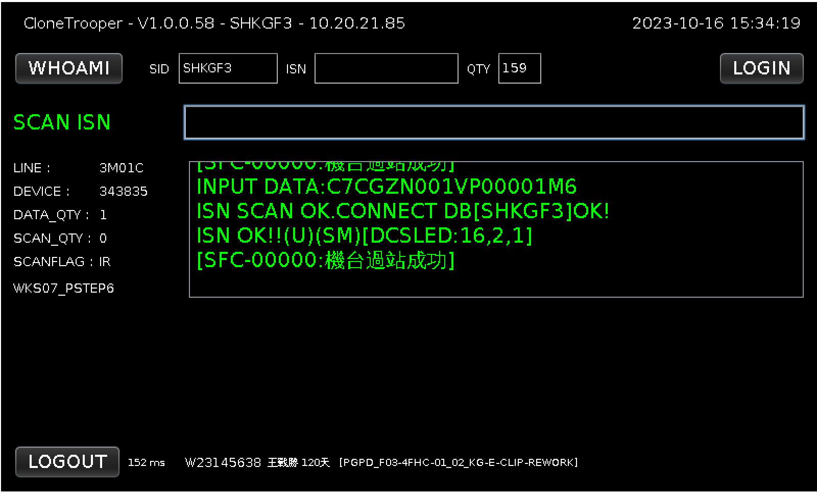
HSG-E-CLIP REWORK- hand brush station
Station name : E-CLIP REWORK
Current site functions :
ROUTING CONTROL stuck
CHK ROUTE passing station
Station GRP : AJG
Brushing method : Scan 70ISN
WKTYPE : WKS07_PSTEP6
Program name: CloneTrooper
WKTYPE functions :
Brush the ISN to pass the station, and check whether the set station has passed the station in order and CHECK ERROR

Slide 51
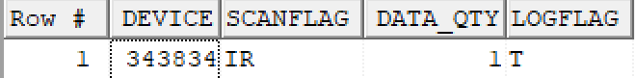
HSG-E-CLIP REWORK- hand brush station
DEVICE configuration information:
DEVICE:SELECT * FROM DEVICE WHERE DEVICE='343834'
DEVICE_CFG:SELECT * FROM DEVICE_CFG WHERE DEVICE='343834'
DEVICE_COLLECT:SELECT * FROM DEVICE_COLLECT WHERE DEVICE='343834'
Flag function:
I : ISN flashes DB first, Multi DB mode
R : COPY the DEVINFO of the SID where the ISN is located back to the SID where the DEVICE is located

Slide 52
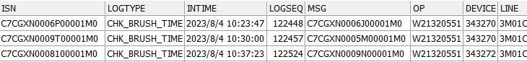
HSG-E-CLIP REWORK- hand brush station
Function Description :
ROUTING CONTROL:
SELECT * FROM ROUTE_STEP_CHECK WHERE STEP='KAM1A AJG '
1.Set the passing record of KAM1A AI9 station and PASS in order
2. If the distance between the two ISNs of the set hand brushing station is less than PDATA1(s) , the previous ISN will report an error and LOG_ISN will exist.
Data changes :
SELECT*FROM MO_D WHERE ISN='C7CGZS001LD00001M6'

Slide 53
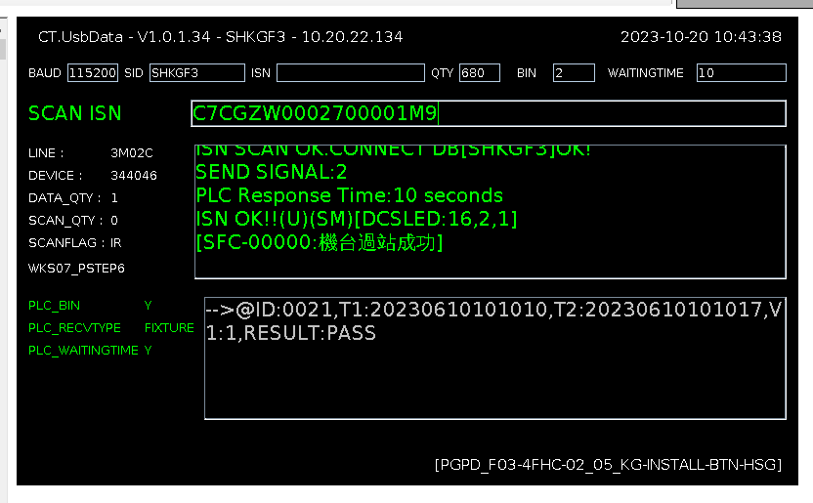
INSTALL RINGER BTN TO HSG- hand brush station
Station name : INSTALL RINGER BTN TO HSG
Current site functions :
PLC communication station
Upload FIXTURE ID, COMDATA table
BIN level inspection
ROUTING CONTROL stuck
CHK ROUTE passing station
Station GRP : AI7
Brushing method : HSG 70ISN
WKTYPE : WKS07_PSTEP6
Program name : CT.UsbData

Slide 54
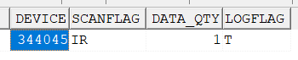
INSTALL RINGER BTN TO HSG- hand brush station
DEVICE configuration information:
SELECT * FROM DEVICE@SHKGP1_RPT WHERE GRP='AI7' AND LINE='3M02C'
DEVICE_CFG:SELECT * FROM DEVICE_CFG@SHKGP1_RPT WHERE DEVICE IN ('344045')
DEVICE_COLLECT:SELECT * FROM DEVICE_COLLECT WHERE DEVICE='344045'
I: Find DB by flashing ISN , multi- DB mode
R: COPY the DEVINFO of the SID where the ISN is located back to the SID where the DEVICE is located

Slide 55
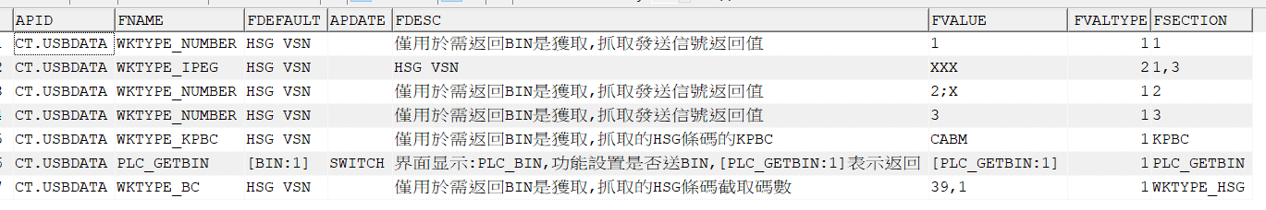
INSTALL RINGER BTN TO HSG- hand brush station
Maintenance involved:
select * FROM AP_INI@SHKGP1_RPT WHERE FVALUE LIKE'% 344045 %';
select * FROM AP_INI@SHKGP1_RPT WHERE FDEFAULT='GROUP_1 5 ';
select * FROM AP_INI@SHKGP1_RPT WHERE FVALUE='GROUP_ 1 5 ' ; -The waiting time is maintained separately by the BY group. If not maintained, the default is 120s
SELECT * FROM AP_INI@SHKGP1_RPT WHERE APID='CT.USBDATA' AND FNAME IN ('PLC_GETBIN','WKTYPE_BC','WKTYPE_IPEG','WKTYPE_KPBC','WKTYPE_NUMBER') ;
PS WKTYPE _IPEG function introduction ( not used yet ) : FVALUE field is the intercepted value maintenance, FVALTYPE field is the required sending return value, FSECTION field is rule judgment ( interception of 3 codes starting from the 1st code ), if CABM:KPSN first 3 codes If fvalue is not maintained, the original logic will be used.

Slide 56
INSTALL RINGER BTN TO HSG- hand brush station
This station involves four functions:
1 : [GET_PLC_RATE:115200] :
Corresponding to the BUAD field of the program interface, the baud rate is 115200 .
2 :[PLC_GETBIN :1]:
1- Grab HSG70 ISN current link CABM kpsn ,
2- Find the 39th code of CABM kpsn . If the 39th code is 1 , then send 1. If it is 2 or X, then send 2. If it is 3 , then pass 3 .
PS added to KPBC : The three information logics of CABM, Code 39 , and Send x are based on the maintenance of the program.
Transmission method: 5 times / second
Log : Oct 19, 2023 8:04:57 PM pega.sfis.Form.UsbData sendRequest
INFO: sendRequest: 2
3 : [PLC_RECVTYPE:1] : The interface displays: PLC_RECVTYPE , receiving FIXTUREID pressure value.
INFO : T/USBserial_lastStr: @ID: 0021,T1:20230610101010,T2:20230610101017,V1:1, RESULT: PASS
4 : [GET_MACTYPE_TIME:10] : It represents the waiting time of 10s . If this time is exceeded, the program will report an error.
NO PLC-SIGNAL BE RETURNED !
COMDATA data storage : DB where ISN is located
select * from comdata@SHKGF3_RPT where sn ='C7CGZW000ZY00001M6';

Slide 57
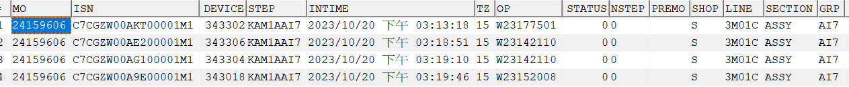
INSTALL RINGER BTN TO HSG- hand brush station
ROUTING CONTROL:
SELECT * FROM ROUTE_STEP_CHECK@SHKGP1_RPT WHERE STEP='KAM1AAI7';
Cooperate with Wktype : WKS07_PSTEP6 Check whether AJG and JEE pass in order , and whether there is an error on the stuck machine . The hand brush station will not be recalculated for the reflow machine UOP .
MO_D stop information :
select * FROM MO_D@SHKGF3_RPT WHERE isn='C7CGZW00AE200001M1';

Slide 58
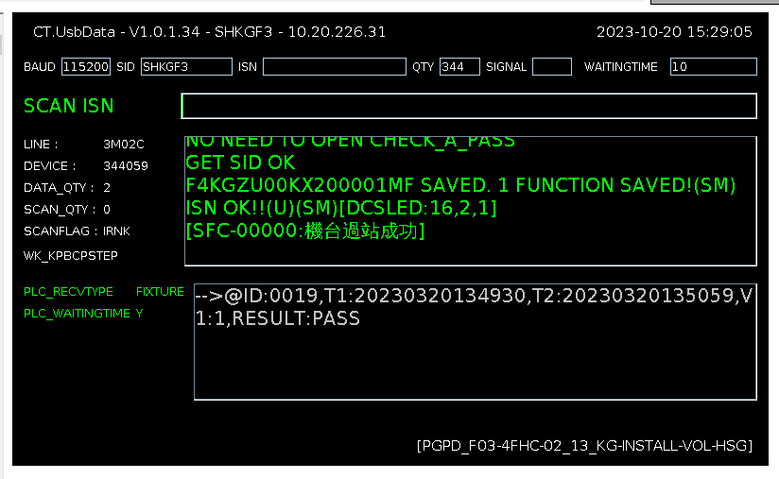
INSTALL RINGER&VOLBKT TO HSG- hand brush station
Station name : INSTALL RINGER&VOLBKT TO HSG
Current site functions :
PLC communication station
Upload FIXTURE ID, COMDATA table
Work order material issuance inspection
KP rules stuck
Allow calling alternative material rules
KP material leakage LINK stuck
KP CONFIG matching level
ROUTING CONTROL stuck
LINK FPC2 and PASS ROUTE
Station GRP : AI8
Brushing method : HSG 70ISN+FPC2
WKTYPE : WK_KPBCPSTEP
Program name : CT.UsbData

Slide 59
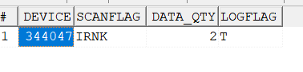
INSTALL RINGER&VOLBKT TO HSG- hand brush station
DEVICE configuration information:
SELECT * FROM DEVICE@SHKGP1_RPT WHERE GRP='AI8' AND LINE='3M02C'
SELECT * FROM DEVICE_CFG@SHKGP1_RPT WHERE DEVICE IN ('344047')
SELECT * FROM DEVICE_COLLECT WHERE DEVICE='344047'
I: Find DB by flashing ISN , multi- DB mode
R: COPY the DEVINFO of the SID where the ISN is located back to the SID where the DEVICE is located
K: represents that the DEVICE is KP LINK station
N: means that the DEVICE is a second-order KP LINK station

Slide 60
INSTALL RINGER&VOLBKT TO HSG- hand brush station
Maintenance involved:
select * FROM AP_INI@SHKGP1_RPT WHERE FVALUE LIKE'% 344047 %';
select * FROM AP_INI@SHKGP1_RPT WHERE FDEFAULT='GROUP_1 4 ';
select * FROM AP_INI@SHKGP1_RPT WHERE FVALUE='GROUP_14'; -The waiting time is maintained separately by the group. If it is not maintained, the default is 120s.
select * FROM AP_INI@SHKGP1_RPT WHERE APID='CT.USBDATA' AND FNAME='CHECK_MOKP'
Supplementary instructions for this maintenance : Only the link kp station will be used. If the device is maintained, if the reflux machine does not release the kpsn to be linked to the current station , you only need to swipe HSG 70ISN to pass the station .

Slide 61
INSTALL RINGER&VOLBKT TO HSG- hand brush station
This station involves three functions:
1 : [GET_PLC_RATE:115200] : Corresponds to the BUAD field of the program interface, the baud rate is 115200 .
2 : [PLC_RECVTYPE:1] : The interface displays: PLC_RECVTYPE, receiving FIXTUREID pressure value.
Log: INFO : T/USBserial_lastStr :
@ID:0019,T1:20230320134930,T2:20230320135059,V1:1,RESULT:PASS
3 : [GET_MACTYPE_TIME:10] : It represents the waiting time of 10s . If this time is exceeded, the program will report an error.
NO PLC-SIGNAL BE RETURNED !
COMDATA data storage : DB where ISN is located
select * from comdata@SHKGF3_RPT where sn ='C7CGZX007JN00001M1';

Slide 62
INSTALL RINGER&VOLBKT TO HSG- hand brush station
Substitute material maintenance:
SELECT * FROM MODEL_D@SHKGS1_RPT WHERE MODELID LIKE'%UPD%' AND ATTRFLAG LIKE'%FPC2%' AND ATTRNM='3M02C';
If set, the alternative material checkpoint will be opened . If the main material does not comply with the rules , check whether the alternative material complies with the LINK rules .
MODELID:(UPD_ISN_KP)
ATTRID:NO_CHK_ITEMR
ATTRNM: Maintain DEVICE.LINE
ATTRINFO: Maintaining both STEP and GRP requires maintenance
ATTRFLAG: Maintain KPBC , separate multiple ones with semicolons

Slide 63
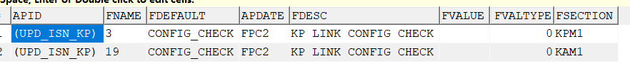
INSTALL RINGER&VOLBKT TO HSG- hand brush station
CONFIG card maintenance:
1. Config check switch setting :
SELECT * FROM AP_INI@SHKGS1_RPT WHERE APID LIKE'%UPD%' AND FDEFAULT='CONFIG_CHECK' AND APDATE='FPC2'; --Only for work orders with config
By route+line ( the fvalue field can be separated by multiple semicolons) +kpbc to open the checkpoint.
2. Config matching relationship setting :
SELECT * FROM item_feature@SHKGp1_RPT WHERE item_type like'%CONFIG_MATCH_MATRIX%' AND FEATUREID='FPC2';
Maintain the matching relationship between HSG70 config and FPC2 config

Slide 64
INSTALL RINGER&VOLBKT TO HSG- hand brush station
CONFIG card maintenance:
3. Config check special settings ( for FAE reflow ) :
SELECT * FROM AP_INI@SHKGS1_RPT WHERE APID LIKE'%(UPD_ISN_KP)%' AND FNAME='FAE_CONFIG' AND FVALUE LIKE'%FPC2%';
When HSG 70ISN link FVALUE maintains kpbc , if 70ISN has entered FAE , it will not be checked. config stuck .
CONFIG check logic judgment
1: Determine whether HSG 70ISN has entered FAE. If it has entered FAE , it will not be checked. config stuck .
2: Determine whether HSG 70isn CONFIG and FPC2 config are consistent.
3: If they are inconsistent, check whether the item_feature has a maintained matching relationship. If they are consistent, if the links are inconsistent, an error will be reported.

Slide 65
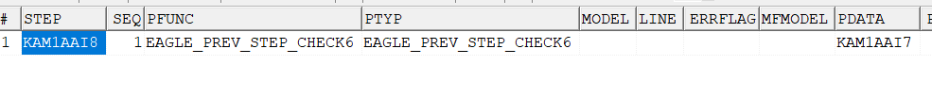
INSTALL RINGER&VOLBKT TO HSG- hand brush station
ROUTING CONTROL:
SELECT * FROM ROUTE_STEP_CHECK@SHKGP1_RPT WHERE STEP='KAM1AAI8';
Cooperate with Wktype : WK_KPBCPSTEP checks whether the AI7 pass is passed , and whether there is an error on the stuck machine . The hand brush station will not be recalculated for the reflow machine UOP .
MO_D stop information :
select * FROM MO_D@SHKGF3_RPT WHERE isn='C7CGZW00AE200001M1';
MOKP_D LINK record :
select * from mokp_d@SHKGF3_RPT where isn='C7CGZX007JN00001M1' AND KPBC='FPC2';

Slide 66
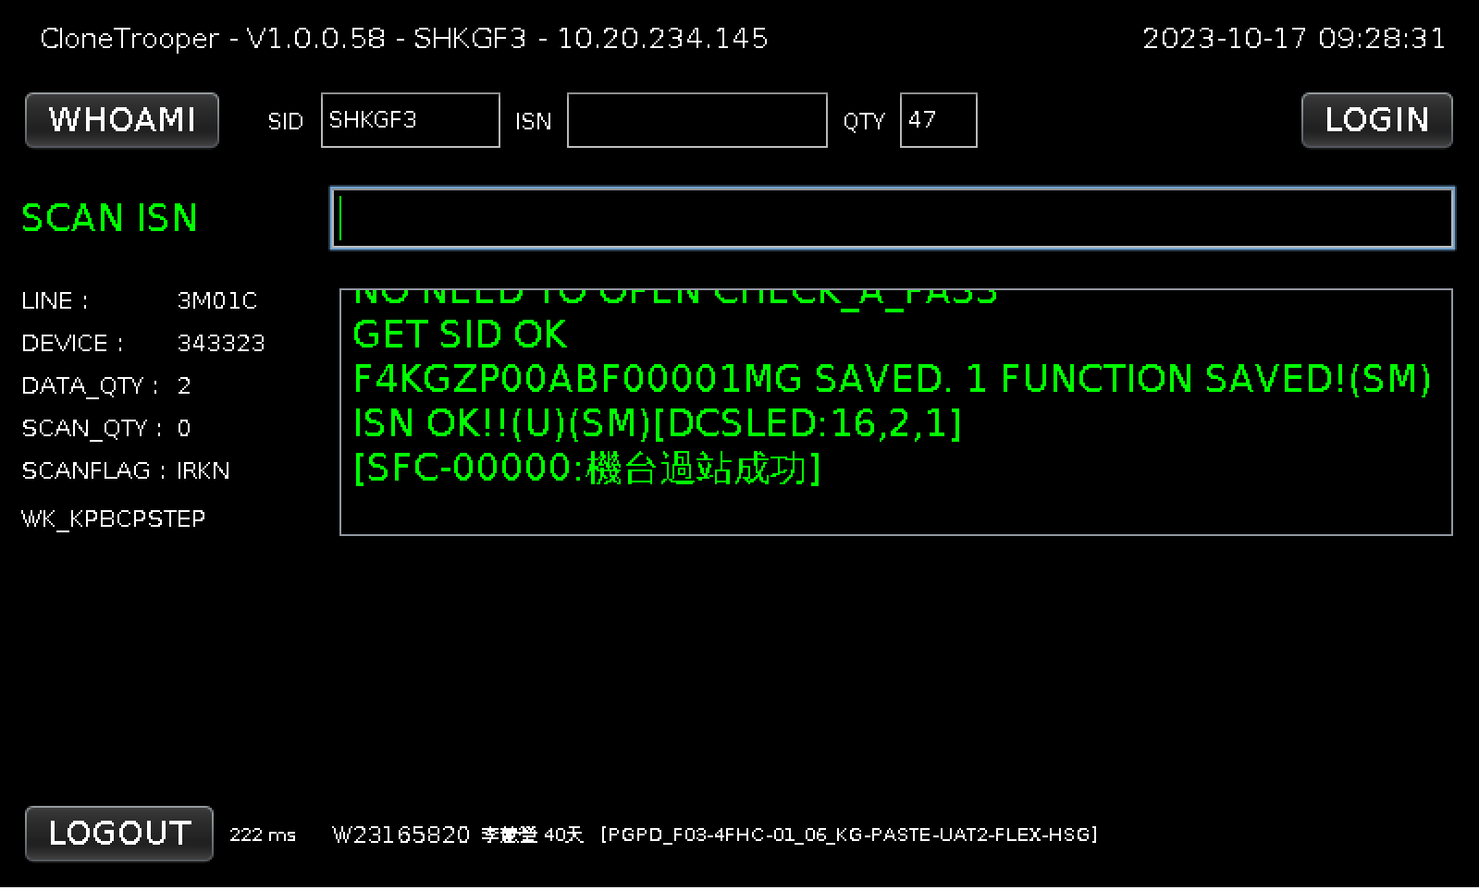
HSG-PASTE UAT2 FLEX TO HSG- hand brush station
Station name : PASTE UAT2 FLEX TO HSG
Current site functions :
LINK KP position
Work order material issuance inspection
KP rules stuck
KP material leakage LINK stuck
OFFLINE CONTROL stuck
KP CONFIG matching level
ROUTING CONTROL stuck
LINK AN14 and PASS ROUTE
Site GRP : AME _
Brushing method : Scan 70ISN +KPSN
WKTYPE : WK_KPBCPSTEP
Program name: CloneTrooper

Slide 67
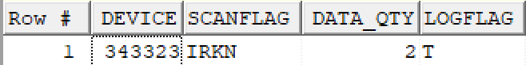
HSG-PASTE UAT2 FLEX TO HSG- hand brush station
DEVICE configuration information:
DEVICE:SELECT * FROM DEVICE WHERE DEVICE='343323'
DEVICE_CFG:SELECT * FROM DEVICE_CFG WHERE DEVICE='343323'
DEVICE_COLLECT:SELECT * FROM DEVICE_COLLECT WHERE DEVICE='343323'
Flag function:
I : ISN flashes DB first, Multi DB mode
R : COPY the DEVINFO of the SID where the ISN is located back to the SID where the DEVICE is located
K : Indicates that the DEVICE is a KP LINK station
N : Indicates that the DEVICE is a second-level KP LINK station

Slide 68
HSG-PASTE UAT2 FLEX TO HSG- hand brush station
Function Description :
ROUTING CONTROL:
SELECT * FROM ROUTE_STEP_CHECK WHERE STEP='KAM1A AME '
Set the pass record of the KAM1A AI8 station and pass in order
WKTYPE functions :
KEYPISN_KPBC (LINK KP is added to the station (ROUTE_STEP.KP1/KP2 sets KPBC)). The KPBC set in the KP1 field must have LINK to pass the station. The KPBC set in KP2 will check whether the work order MOKP has issued materials. If so, You must LINK to pass the station) .
WK_KPBCPSTEP adds routing control function based on KEYPISN_KPBC .
SELECT*FROM ROUTE_STEP WHERE STEP='KAM1AAME'

Slide 69
HSG-PASTE UAT2 FLEX TO HSG- hand brush station
OFFLINE processing :
MODEL_D maintains OFFLINE processing station:
SELECT*FROM MODEL_D WHERE ATTRID='OFFLINE_CONTROL' AND ATTRFLAG='AN14'
MODELID is KPBC , ATTRITEM is the station passing sequence, ATTRINFO is the station name
AP_INI maintenance checkpoint:
When LINK AN14 , perform OFFLINE processing flow CHECK . FSECTION is divided into two modes: BY LINE and SP . BY LINE has a higher priority than SP.
SELECT * FROM AP_INI WHERE APID='CHK_KPSN_OC' AND FNAME='OFFLINE_CONTROL'

Slide 70
HSG-PASTE UAT2 FLEX TO HSG- hand brush station
1. When the checkpoint is turned on, check whether the KPSN_TRACK table has data. If not, an error will be reported.
2. Level setting description :
2.1 AN14 is not maintained in the FVALUE of AP_INI and is not stuck.
2.2 AN14 is not maintained in FVALUE of AP_INI , but FVALTYPE=0, no stuck
2.3 When the jam level is turned on, KPSN ’s INTIME <AP_INI.APDATE will not jam (outsourced: compare the system time used and the maintenance time; homemade: capture the KPSN INTIME time and compare the maintenance time)
SELECT * FROM AP_INI WHERE APID='CHK_KPSN_OC' AND FSECTION='SP'
has not completed OFFLINE processing in the DB where KPSN is located . The status is incorrect ( STATUS is 1 ) and an error will be reported.
SELECT * FROM KPSN_TRACK WHERE KPSN='C7CGXV000PK00001M5'

Slide 71
HSG-PASTE UAT2 FLEX TO HSG- hand brush station
CONFIG checkpoint:
1.CONFIG CHECK switch setting :
BY ROUTE+LINE ( FVALUE field can be separated by multiple semicolons) +KPBC to open the level
SELECT * FROM AP_INI WHERE APID='(UPD_ISN_KP)' AND FDEFAULT='CONFIG_CHECK' AND APDATE='AN14'
2.CONFIG matching relationship settings:
Maintain the matching relationship between HSG70 CONFIG and AN14
SELECT * FROM ITEM_FEATURE WHERE ITEM_TYPE='CONFIG_MATCH_MATRIX' and featureid ='AN14'
Explanation of field names:
ITEM is ISN CONFIG
FEATUREID material KPBC
FEATURENM is the material name
FEATURE VALUE is the material CONFIG
ITEM_TYPE fixed CONFIG_MATCH_MATRIX

Slide 72
HSG-PASTE UAT2 FLEX TO HSG- hand brush station
3. CONFIG CHECK special settings (for reflow machines)
When 81&70ISN LINK FVALUE maintains KPBC , if 81&70ISN has entered the FAE , it will not check CONFIG .
SELECT * FROM AP_INI WHERE APID='(UPD_ISN_KP)' AND FNAME='FAE_CONFIG'
FAE machine grabbing method:
If there is information, it is the FAE machine:
SELECT * FROM MO_ROUTE_OWNER WHERE ISN ='$ 81&70isn $' AND OWNER_GRP NOT IN (maintained area );
Maintenance area capture value :
SELECT FVALUE FROM AP_INI WHERE APID ='TSP _CHKROUTE _EMERLAD' AND FNAME ='FAE_EXCEPTION' AND FSECTION ='SP ' ;
4. CONFIG check logic judgment:
4.1 Determine whether HSG 70ISN has entered the FAE . If it has entered the FAE , it will not check CONFIG .
4.2 Determine whether HSG 70ISN CONFIG and AN14 CONFIG are consistent
4.3 If they are inconsistent, check whether ITEM_FEATURE maintains a matching relationship. If they are consistent, LIKN will be displayed . If they are inconsistent, an error will be reported.

Slide 73
HSG-PASTE UAT2 FLEX TO HSG- hand brush station
Data changes :
SELECT*FROM MO_D WHERE ISN='C7CGZS002BN00001M5'
SELECT*FROM MOKP_D WHERE KPSN='F4KGZR00Z5K00001MG'

Slide 74
HSG-PASTE UAT2 FLEX TO HSG- hand brush station
Extended description:
Alternative material logic: ROUTE_STEP.KP2 is set to AN14 , the work order is issued with AN14 , and the line body is set with alternative materials. If it meets the work order issue or has alternative material logic, you can LINK
SELECT * FROM ROUTE_STEP WHERE STEP='KAM1AAI1';-- This station has set KP2:AN14
SELECT * FROM MOKP WHERE MO='24147955' AND KPBC='AN14'; --Query whether the work order has materials issued
select * from MODEL_D where MODELID='(UPD_ISN_KP)' AND ATTRNM='3M01C' --Check whether there is a substitute material set
MODELID:(UPD_ISN_KP)
ATTRID:NO_CHK_ITEMR
ATTRNM: Maintain DEVICE.LINE
ATTRINFO: Maintain STEP or GRP
ATTRFLAG: Maintain KPBC , separate multiple ones with semicolons

Slide 75
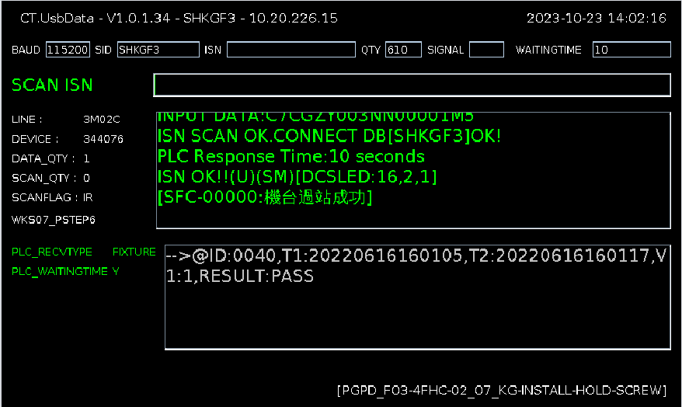
INSTALL HOLD BKT-FAST 3XSCREW -Hand Brush Station
Station name : INSTALL HOLD BKT-FAST 3XSCREW
Current site functions :
PLC communication station
Upload FIXTURE ID, COMDATA table
ROUTING CONTROL stuck
CHK ROUTE passing station
Station GRP : AIJ
Brushing method : HSG 70ISN
WKTYPE : WKS07_PSTEP6
Program name : CT.UsbData

Slide 76
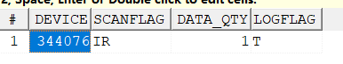
INSTALL HOLD BKT-FAST 3XSCREW -Hand Brush Station
DEVICE configuration information:
SELECT * FROM DEVICE@SHKGP1_RPT WHERE GRP='AIJ' AND LINE='3M02C'
DEVICE_CFG:SELECT * FROM DEVICE_CFG@SHKGP1_RPT WHERE DEVICE IN ('344076')
DEVICE_COLLECT:SELECT * FROM DEVICE_COLLECT WHERE DEVICE='344076'
I: Find DB by flashing ISN , multi- DB mode
R: COPY the DEVINFO of the SID where the ISN is located back to the SID where the DEVICE is located

Slide 77
INSTALL HOLD BKT-FAST 3XSCREW- hand brush station
Maintenance involved:
select * FROM AP_INI@SHKGP1_RPT WHERE FVALUE LIKE'%3440 76 %';
select * FROM AP_INI@SHKGP1_RPT WHERE FDEFAULT='GROUP_1 4 ';
select * FROM AP_INI@SHKGP1_RPT WHERE FVALUE='GROUP_14'; -The waiting time is maintained separately by the group. If it is not maintained, the default is 120s.
This station involves three functions:
1 : [GET_PLC_RATE:115200] : Corresponds to the BUAD field of the program interface , the baud rate is 115200 .
2 : [PLC_RECVTYPE:1] : The interface displays: PLC_RECVTYPE , receiving FIXTUREID pressure value.
@ID : 1005,T1:20231019203625,T2:20231019203639,V1:1, RESULT: PASS
3 : [GET_MACTYPE_TIME:10] : It represents the waiting time of 10s . If this time is exceeded, the program will report an error.
NO PLC-SIGNAL BE RETURNED !

Slide 78
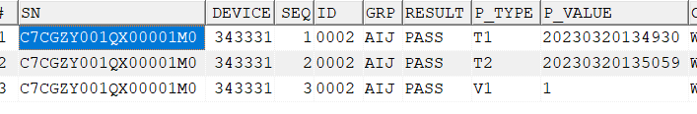
INSTALL HOLD BKT-FAST 3XSCREW- hand brush station
ROUTING CONTROL:
SELECT * FROM ROUTE_STEP_CHECK@SHKGP1_RPT WHERE STEP='KAM1AAIJ';
Cooperate with Wktype : WKS07_PSTEP6 to check whether the AME is passed , and whether there is an error when the card is turned off . The hand brush station will not be recalculated for the reflow machine UOP .
MO_D stop information :
SELECT * FROM MO_D WHERE ISN='C7CGZW000F900001M1';
SELECT * FROM COMDATA WHERE SN='C7CGZY001QX00001M0';

Slide 79

HSG-FASTEN ANT4 2X SCREWS- hand brush station
Station name : FASTEN ANT4 2X SCREWS
Current site functions :
ROUTING CONTROL stuck
CHK ROUTE passing station
Station GRP : PTI
Brushing method : Scan 70ISN
WKTYPE : WKS07_PSTEP6
Program name: CloneTrooper
WKTYPE functions :
Brush the ISN to pass the station, and check whether the set station has passed the station in order and CHECK ERROR

Slide 80

HSG-FASTEN ANT4 2X SCREWS- hand brush station
DEVICE configuration information:
DEVICE:SELECT * FROM DEVICE WHERE DEVICE='343341'
DEVICE_CFG:SELECT * FROM DEVICE_CFG WHERE DEVICE='343341'
DEVICE_COLLECT:SELECT * FROM DEVICE_COLLECT WHERE DEVICE='343341'
Flag function:
I : ISN flashes DB first, Multi DB mode
R : COPY the DEVINFO of the SID where the ISN is located back to the SID where the DEVICE is located

Slide 81
HSG-FASTEN ANT4 2X SCREWS- hand brush station
Function Description :
ROUTING CONTROL:
SELECT * FROM ROUTE_STEP_CHECK WHERE STEP='KAM1A PTI '
Set the pass record of KAM1A AIJ station and pass in order
Data changes :
SELECT*FROM MO_D WHERE ISN='C7CGZS003NB00001M5'

Slide 82
HSG-PRESS UAT2 FLEX TO HSG- hand brush station
Station name : PRESS UAT2 FLEX TO HSG
Current site functions :
PLC communication station
ROUTING CONTROL stuck
CHK ROUTE passing station
Station GRP : PH6
Brushing method : HSG 70ISN
WKTYPE : WKS07_PSTEP6
Program name : CT.UsbData

Slide 83

HSG-PRESS UAT2 FLEX TO HSG- hand brush station
DEVICE configuration information:
SELECT * FROM DEVICE@SHKGP1_RPT WHERE GRP='PH6' AND LINE='3M02C'
DEVICE_CFG:SELECT * FROM DEVICE_CFG@SHKGP1_RPT WHERE DEVICE IN ('344188')
DEVICE_COLLECT:SELECT * FROM DEVICE_COLLECT WHERE DEVICE='344188'
I: Find DB by flashing ISN , multi- DB mode
R: Change the ISN location DEVINFO COPY of SID returns to the SID where DEVICE is located

Slide 84
HSG-PRESS UAT2 FLEX TO HSG- hand brush station
Maintenance involved:
select * FROM AP_INI@SHKGP1_RPT WHERE FVALUE LIKE'%344 188 %';
select * FROM AP_INI@SHKGP1_RPT WHERE FDEFAULT='GROUP_12';
This station involves two functions:
1 : [GET_PLC_RATE:115200] : Corresponds to the BUAD field of the program interface , the baud rate is 115200 .
2 : [PLC_GETCHECKROUTE:1] : The interface displays: PLC_CHK_ROUTE, whether to send CHKROUTE in the first shot setting NG:3/OK:4
Log : INFO : INPUT DATA:C7CGZV004FF00001M8
Oct 19, 2023 8:03:47 PM pega.sfis.Form.UsbData sendRequest
INFO: sendRequest:4
Oct 19, 2023 8:03:47 PM pega.sfis.Form.UsbData sendRequest
INFO: sendRequest:4

Slide 85
HSG-PRESS UAT2 FLEX TO HSG- hand brush station
ROUTING CONTROL:
SELECT * FROM ROUTE_STEP_CHECK@SHKGP1_RPT WHERE STEP='KAM1APH6';
Cooperate with Wktype : WKS07_PSTEP6 to check whether the PTI is passed , and whether there is an error when the machine is stuck . The hand brush station will not be recalculated for the reflow machine UOP .
MO_D stop information :
select * FROM MO_D WHERE ISN ='C7CGZY001R300001M0';

Slide 86

HSG-FASTEN UAT2 2X SCREWS- hand brush station
Station name : FASTEN UAT2 2X SCREWS
Current site functions :
ROUTING CONTROL stuck
CHK ROUTE passing station
Station GRP : AIQ
Brushing method : Scan 70ISN
WKTYPE : WKS07_PSTEP6
Program name: CloneTrooper

Slide 87

HSG-FASTEN UAT2 2X SCREWS- hand brush station
DEVICE configuration information:
DEVICE:SELECT * FROM DEVICE WHERE DEVICE='343878'
DEVICE_CFG:SELECT * FROM DEVICE_CFG WHERE DEVICE='343878'
DEVICE_COLLECT:SELECT * FROM DEVICE_COLLECT WHERE DEVICE='343878'
Flag function:
I: ISN flashes the DB first, Multi DB mode
R: COPY the DEVINFO of the SID where the ISN is located back to the SID where the DEVICE is located

Slide 88
HSG-FASTEN UAT2 2X SCREWS- hand brush station
Function Description :
ROUTING CONTROL:
SELECT * FROM ROUTE_STEP_CHECK WHERE STEP='KAM1A AIQ '
Set the pass record of KAM1A PH6 station and pass in order
Data changes :
SELECT*FROM MO_D WHERE ISN='C7CGZS001EM00001M6'

Slide 89

HSG-PASTE MIC3 TO HSG- Hand brush station
Station name : PASTE MIC3 TO HSG
Current site functions :
ROUTING CONTROL stuck
CHK ROUTE passing station
Station GRP : AIT
Brushing method : Scan 70ISN
WKTYPE : WKS07_PSTEP6
Program name: CloneTrooper

Slide 90

HSG-PASTE MIC3 TO HSG- Hand brush station
DEVICE configuration information:
DEVICE:SELECT * FROM DEVICE WHERE DEVICE='343358'
DEVICE_CFG:SELECT * FROM DEVICE_CFG WHERE DEVICE='343358'
DEVICE_COLLECT:SELECT * FROM DEVICE_COLLECT WHERE DEVICE='343358'
Flag function:
I : ISN flashes DB first, Multi DB mode
R : COPY the DEVINFO of the SID where the ISN is located back to the SID where the DEVICE is located

Slide 91
HSG-PASTE MIC3 TO HSG- Hand brush station
Function Description :
ROUTING CONTROL:
SELECT * FROM ROUTE_STEP_CHECK WHERE STEP='KAM1A AIT '
Set the pass record of the blocked KAM1A AIQ station and PASS in order
Data changes :
SELECT*FROM MO_D WHERE ISN='C7CGZS0021R00001M6'

Slide 92

HSG-PRESS MIC3 TO HSG-STARFIGHT STATION
Station name : AJ1
Position function :
STARFIGHT automated station
Upload FIXTURE ID, COMDATA table
ROUTING CONTROL stuck
CHK ROUTE passing station
DEVICE settings :
SELECT * FROM DEVICE WHERE DEVICE='308907'
ALLDEV settings :
DEVICE requires MAPPING in ALLDEV
SELECT * FROM ALLDEV WHERE DEVALUE='308907 '

Slide 93
HSG-PRESS MIC3 TO HSG-STARFIGHT STATION
URL:http://172.28.147.139/StarFighter.Kangol/B
QUERY_RECORD参数:
{
"c":"QUERY_RECORD",
"station_id":"PGPD_F03-4FHC-02_4_PRESS-MIC3-TO-HSG",
"p":"unit_process_check;",
"sn":"C7CGZZ0011N00001M9"
}
ADD_RECORD参数：
{
"c":"add_record",
"sn":"C7CGZZ001M700001M9",
"station_id":"PGPD_F03-4FHC-02_4_PRESS-MIC3-TO-HSG",
"test_station_name":"PRESS-MIC3-TO-HSG",
"start_time":"2023-10-24 09:50:17",
"stop_time":"2023-10-24 09:50:19",
"mrm_data":"ID:0001-3,T1:20231024095017,T2:20231024095019,V1:3.3-3.28-3.28-3.28-3.28,V2:3.284,RESULT:PASS",
"result":"pass",
"product":"Kangol",
"mac_address":"68:ed:a4:64:76:09",
}

Slide 94
HSG-PRESS MIC3 TO HSG-STARFIGHT STATION
unit_process_check parameter logic:
Check UOP with ROUTE_STEP_CHECK and ALLDEV_CFG
The line body where ALLDEV_CFG table DEVICE is located sets STATUS to 1 and UOP is enabled.
SELECT * FROM ALLDEV_CFG WHERE M_KEY='PGPD_F03-4FHC-02'
ROUTE_STEP_CHECK setting check level :
SELECT * FROM route_step_CHECK WHERE STEP='KAM1AAJ1';
Set 3M0 1 C; 3M0 2 C; 3M03C line body block KAM1AAIT pass station PASS record
Set 3M0 1 C; 3M0 2 C; 3M03C line body can only be tested once at the current station (AONE means it can only be tested once, regardless of whether it passes or fails;)

Slide 95

HSG-PRESS MIC3 TO HSG-STARFIGHT STATION
COMDATA storage information :
SELECT * FROM COMDATA@SHKGF3_RPT WHERE SN='C7CGZZ0017K00001M9' AND GRP='AJ1';
MO_D stop information :
SELECT * FROM MO_D@SHKGF3_RPT WHERE GRP='AJ1' AND LINE = '3M02 C ' AND INTIME>SYSDATE -0.02
MO_ROUTE_PDCA storage records :
SELECT * FROM MO_ROUTE_PDCA WHERE ISN='C7CGZZ0017K00001M9' AND GRP =' AJ1 '

Slide 96

HSG-INSTALL MIC3 COWLING- hand brush station
Station name : INSTALL MIC3 COWLING
Current site functions :
ROUTING CONTROL stuck
CHK ROUTE passing station
Position GRP : AJ2
Brushing method : Scan 70ISN
WKTYPE : WKS07_PSTEP6
Program name: CloneTrooper

Slide 97

HSG-INSTALL MIC3 COWLING- hand brush station
DEVICE configuration information:
DEVICE:SELECT * FROM DEVICE WHERE DEVICE='343365'
DEVICE_CFG:SELECT * FROM DEVICE_CFG WHERE DEVICE='343365'
DEVICE_COLLECT:SELECT * FROM DEVICE_COLLECT WHERE DEVICE='343365'
Flag function:
I : ISN flashes DB first, Multi DB mode
R : COPY the DEVINFO of the SID where the ISN is located back to the SID where the DEVICE is located

Slide 98
HSG-INSTALL MIC3 COWLING- hand brush station
Function Description :
ROUTING CONTROL:
SELECT * FROM ROUTE_STEP_CHECK WHERE STEP='KAM1A AJ2 '
Set the pass record of KAM1A AJ1 station and pass in order
Data changes :
SELECT*FROM MO_D WHERE ISN='C7CGZS002RQ00001M5'

Slide 99
HSG-HBT- Test Station
Station name : GUO
Position function :
ROUTING CONTROL stuck
Test AAB mode
10 minutes stuck
CHK ROUTE passing station
DEVICE settings
SELECT * FROM DEVICE WHERE DEVICE='304766'
ALLDEV settings
SELECT * FROM ALLDEV WHERE DEVALUE='304766'

Slide 100
HSG-HBT- Test Station
QUERY
CHECK UOP
ADD
MO_D transfers and stores MO_ROUTE_PDCA records

Slide 101
HSG-HBT- Test Station
unit_process_check :
Check UOP with ROUTE_STEP_CHECK and ALLDEV_CFG
The line body where ALLDEV_CFG table DEVICE is located sets STATUS to 1 and UOP is enabled.
SELECT * FROM ALLDEV_CFG WHERE M_KEY='PGPD_F03-4FHC-03'

Slide 102
HSG-HBT- Test Station
ROUTE_STEP_CHECK setting block
SELECT * FROM ROUTE_STEP_CHECK WHERE STEP=' KAM1TGUO';
The first one sets the line check maintained by the LINE field and the passing record of the station maintained by the PDATA field.
The second line is set to be maintained by the LINE field. The three tests of the current station are fixture A--- fixture A --- fixture B. The mode can also be AB B Or ABA , otherwise it will be blocked by bobcat and an error will be reported : 0 SFC_OK UNIT OUT OF PROCESS Over fail count Go to FA-CHECK-IN.
TIGER_RETEST_RULE: It is the current corresponding test mode, Pfunc & ptype are fixed, line is the card line body, pdata1 sets the number of times, PDATA can set AAB, ABC, AAA
The third setting is to compare the retest time of the line machine maintained in the blocked LINE field after the current station test fails with the last test time. If it exceeds, UNIT OUT OF PROCESS; Over retest time.GO TO FAE will be reported. check in!!
CHKTIME_RULE: is the current corresponding test mode, Pfunc & ptype are fixed, line is the card line body, pdata Fixed to XXX , pdata1 is fixed to 0 , TZ is the blocking time in minutes, this field cannot be empty or greater than 99 , day is the hour

Slide 103

HSG-PASTE BTN FLEX TO HSG- Hand brush station
Station name : PASTE BTN FLEX TO HSG
Current site functions :
ROUTING CONTROL stuck
CHK ROUTE passing station
Station GRP : AIR
Brushing method : Scan 70ISN
WKTYPE : WKS07_PSTEP6
Program name: CloneTrooper

Slide 104

HSG-PASTE BTN FLEX TO HSG- Hand brush station
DEVICE configuration information:
DEVICE:SELECT * FROM DEVICE WHERE DEVICE='343379'
DEVICE_CFG:SELECT * FROM DEVICE_CFG WHERE DEVICE='343379'
DEVICE_COLLECT:SELECT * FROM DEVICE_COLLECT WHERE DEVICE='343379'
Flag function:
I: ISN flashes the DB first, Multi DB mode
R: COPY the DEVINFO of the SID where the ISN is located back to the SID where the DEVICE is located

Slide 105
HSG-PASTE BTN FLEX TO HSG- Hand brush station
Function Description :
ROUTING CONTROL:
SELECT * FROM ROUTE_STEP_CHECK WHERE STEP='KAM1A AIR '
Set the pass records of KAM1A AJ2 and KAM1A GUO and pass them in order
Data changes :
SELECT*FROM MO_D WHERE ISN='C7CGZS0035Q00001M5'

Slide 106

HSG-PASTE PRESS MIC4 TO SPK BKT- hand brush station
Station name : PASTE PRESS MIC4 TO SPK BKT
Current site functions :
PLC communication station
Upload FIXTURE ID, COMDATA table
ROUTING CONTROL stuck
CHK ROUTE passing station
Reflow machine LINK KP inspection
Station GRP : AIS
Brushing method : Scan 70ISN
WKTYPE : WKS07_PSTEP6& WK_KPBC_CHECK
Program name: C T . UsbData&CloneTrooper
Normal line usage :
WKS07_PSTEP6 and CT . UsbData
CloneTrooper for return lines or heavy industry lines.

Slide 107

HSG-PASTE PRESS MIC4 TO SPK BKT- hand brush station
DEVICE configuration information:
DEVICE:SELECT * FROM DEVICE WHERE DEVICE IN ('343382','343039')
DEVICE_CFG:SELECT * FROM DEVICE_CFG WHERE DEVICE IN ('343382','343039')
DEVICE_COLLECT:SELECT * FROM DEVICE_COLLECT WHERE DEVICE IN ('343382','343039')

Slide 108
HSG-PASTE PRESS MIC4 TO SPK BKT- hand brush station
Position function
AP_INI configuration information:
SELECT * FROM AP_INI WHERE APID='CT.USBDATA' AND fdefault='GROUP_3'
FNAME: GROUP maintains all devices under this group GROUP_3
FNAME: PLC_GROUP maintains the function settings of this group GROUP_3 ( there are currently 4 functions )
[GET_PLC_RATE:115200] Set the baud rate to 115200
[ PLC_GETCHECKROUTE:1] Enable return CHK ROUTE PASS/NG
[PLC_RECVTYPE:1] Turn on receiving fixture information
[ GET_MACTYPE_TIME:10] Maintenance PLC return time is 10 seconds

Slide 109
HSG-PASTE PRESS MIC4 TO SPK BKT- hand brush station
WKTYPE WK_KPBC_CHECK description:
If the reflow machine has LINK KP, there is no need to go through the PLC for lamination . It needs to go through this station. Therefore, it is used to determine whether the ISN currently has a LINK designated KP .
AP_INI configuration information :
SELECT * FROM AP_INI WHERE APID='WK_KPBC_CHECK' AND FNAME='KAM1AAIS'
STEP maintained by FNAME checks that FSECTION corresponds to KP2 of STEP
Whether there is LINK in field KP. If there is LINK , an error will be reported if there is no LINK .

Slide 110

HSG-PASTE PRESS MIC4 TO SPK BKT- hand brush station
Common functions :
ROUTING CONTROL:
SELECT * FROM ROUTE_STEP_CHECK WHERE STEP='KAM1AAIS'
Set the passing records of KAM1AAIR and KAM1TKHO and pass them in order
COMDATA storage information :
SELECT * FROM COMDATA WHERE SN='C7CGZR00P8800001M1' AND DEVICE='343382'

Slide 111

HSG-INSTALL DIC SPRINGS&PASTE DOCK FLEX- hand brush station
Station name : INSTALL DIC SPRINGS&PASTE DOCK FLEX
Current site functions :
PLC communication station
Upload FIXTURE ID, COMDATA table
Work order material issuance inspection
KP rules stuck
ROUTING CONTROL stuck
LINK FPC4 and PASS ROUTE
Station GRP : AIL
Brushing method : Scan 70 ISN + Dock flex VSN
WKTYPE : WK_KPBCPSTEP
Program name: CT.UsbData
Smart driver baud rate : 115200

Slide 112

HSG-INSTALL DIC SPRINGS&PASTE DOCK FLEX- hand brush station
SFIS configuration information :
DEVICE:SELECT * FROM DEVICE WHERE DEVICE='343042'
DEVICE_CFG:SELECT * FROM DEVICE_CFG WHERE DEVICE='343042'
DEVICE_COLLECT:SELECT * FROM DEVICE_COLLECT WHERE DEVICE='343042'
ROUTE_STEP: SELECT * FROM ROUTE_STEP WHERE STEP='KAM1AAIL'

Slide 113

HSG-INSTALL DIC SPRINGS&PASTE DOCK FLEX- hand brush station
Intelligent screwdriver PLC interaction flow chart :

Slide 114
HSG-INSTALL DIC SPRINGS&PASTE DOCK FLEX- hand brush station
Instructions for the process and brushing method :
The first shot flashes into the ISN and requires CHECK ROUTE at the same time , but it does not stop and sends a signal to the driver (unlock command: UNLOCK ). If CHECK ROUTE fails, an error will be reported directly.
The second shot is to flash KPSN and CHEK whether the KPSN is OK . The temporary storage is not LINK KP but not station. Wait for the electric screwdriver to upload the data and store it in the COMDATA table. Finally, the station is passed and LINK KP is passed.
PS: The waiting time for uploading is 2 minutes. You cannot flash other ISNs within 2 minutes . Flashing other ISNs is invalid. If there is no data uploaded for more than 2 minutes, you must pass the site and LINK before you can flash the next ISN .
WKTYPE WK _KPBCPST EP Description :
LINK KP and pass the station (ROUTE_STEP.KP1/KP2 sets KPBC). The KPBC set in the KP1 field must require LINK to pass the station. The KPBC set in KP2 depends on whether the work order MOKP has issued materials. If so, it must LINK can pass the station and add ROUTING CONTROL function .
ROUTING CONTROL :
SELECT * FROM ROUTE_STEP_CHECK WHERE STEP='KAM1AAIL'
Set the checkpoint KAM1AAIS station PASS pass record

Slide 115

HSG-INSTALL DIC SPRINGS&PASTE DOCK FLEX- hand brush station
The PLC transmission instruction is divided into two parts for uploading . It mainly captures the part with value in the second part and ignores UNLOCK_SUCCESS .
1. UNLOCK_SUCCESS
2. ID:0,A1:10.0,A2:1.30,A3:300,A4:364,A5:1.0,A6:0.996,A7:0.0,A8:0.0,A9:0.0,A10:5.469,RESULT:PASS; ID:0,B1:10.0,B2:0.57,B3:1000,B4:1613,B5:1.250,B6:1.246,B7:0.0,B8:0.0,B9:0.0,B10:4.456,RESULT:PASS;ID: 0,C1:10.0,C2:0.63,C3:1000,C4:812,C5:1.250,C6:1.246,C7:0.0,C8:0.0,C9:0.0,C10:4.907,RESULT:PASS ;
Explanation of code nouns:
ID: MAC, A1: TIME, A2 : Actual value of locking time, A3: Standard value of speed, A4: Actual value of speed, A5: Standard value of torque, A6: Actual value of torque, A7: Standard value of locking turns, A8 : The upper limit of the number of locking turns, A9: The lower limit of the number of locking turns, A10: The actual number of locking turns, A11: The standard value of the fitting angle, A12: The upper limit of the fitting angle, A13: The lower fitting angle Limit value, A14: Actual value of fitting angle, RESULT: PASS ;
A, B, and C represent the screw number . B and C are interpreted as the same as A.

Slide 116

HSG-INSTALL DIC SPRINGS&PASTE DOCK FLEX- hand brush station
COMDATA information storage :
SELECT * FROM COMDATA WHERE SN='C7CGZR00MRW00001M1' AND DEVICE='343386'
COMDATA field description:
SN: ISN
DEVICE: DEVICE
ID: ID of the electric screwdriver (for example, ID : 0034 )
GRP: Passing GRP
RESULT: Uploaded PASS or FAIL record (for example, RESULT:PASS )
P_TYPE: ABC replaces the screw number, that is, the first screw is A , the second screw is B, the third screw is C , and so on. Take the first screw, which is distance A. We define the first value as A1 , the second value as A2, and so on.
P_VALUE: data value

Slide 117
HSG-INSTALL DIC SPRINGS&PASTE DOCK FLEX- hand brush station
MO_D stop record :
SELECT * FROM MO_D WHERE ISN='C7CGZR00MRW00001M1'
MOKP_D LINK record :
SELECT * FROM MOKP_D WHERE ISN='C7CGZR00N9200001M1' AND STEP='KAM1AAIL'

Slide 118

HSG-FASTEN DOCK 3X SCREWS -Hand brush station
Station name : FASTEN DOCK 3X SCREWS
Station function :
ROUTING CONTROL stuck
CHK ROUTE passing station
Position : AJ5
Brushing method : Scan 70ISN
Program name : CloneTrooper
WKTYPE : WKS07_PSTEP6

Slide 119

HSG-FASTEN DOCK 3X SCREWS -Hand brush station
DEVICE related settings
D EVICE_CFG:SELECT * FROM DEVICE_CFG WHERE device='351541'
DEVICE:SELECT * FROM DEVICE WHERE device='351541'
DEVICE_CLLECT:SELECT * FROM DEVICE_COLLECT WHERE device='351541'
Flag function :
I: ISN first search for DB , Multi DB mode
R: Change the DEVINFO of the SID where the ISN is located COPY back to the SID where DEVICE is located
routing control settings
SELECT * FROM ROUTE_STEP_CHECK WHERE step='KAM1APGY'
Cooperate with WKTYPE WKS07_PSTEP6 to check whether the set PDATA station passes in SEQ order and check error

Slide 120

HSG-FASTEN 2X ANT SCREWS -Hand brush station
Station name : FASTEN 2X ANT SCREWS
Station function :
ROUTING CONTROL stuck
CHK ROUTE passing station
Station : PH0
Brushing method : Scan 70ISN
Program name : CloneTrooper
WKTYPE : WKS07_PSTEP6

Slide 121

HSG-FASTEN 2X ANT SCREWS -Hand brush station
DEVICE settings
SELECT * FROM DEVICE_CFG WHERE DEVICE='351549'
SELECT * FROM DEVICE WHERE device='351549'
DEVICE_COLLECT: SELECT * FROM DEVICE_COLLECT WHERE device='351549'
Flag function :
I: ISN first search for DB , Multi DB mode
R: Change the DEVINFO of the SID where the ISN is located COPY back to the SID where DEVICE is located
ROUTING_CONTROL related settings
SELECT * FROM ROUTE_STEP_CHECK WHERE step='KAM1APH0'
Cooperate with WKTYPE WKS07_PSTEP6 to check whether the set PDATA station passes in SEQ order and check error .

Slide 122
HSG-PRESS DOCK FLEX-STARFIGHT STATION
Station name : PGU
Position function :
STARFIGHT automated station
Upload FIXTURE ID, COMDATA table
ROUTING CONTROL stuck
Test AONE mode
CHK ROUTE passing station
DEVICE settings :
SELECT * FROM DEVICE WHERE DEVICE='308900'
ALLDEV settings :
DEVICE requires MAPPING in ALLDEV
SELECT * FROM ALLDEV WHERE DEVALUE='308900'

Slide 123
HSG-PRESS DOCK FLEX-STARFIGHT STATION
Official machine URL : http://172.28.147.139/StarFighter.Kangol/B _
QUERY_RECORD parameters :
{
" c":"QUERY_RECORD ",
"station_id":"PGPD_F03-4FHC-01_5_PRESS-DOCK-FLEX",
"p":" unit_process_check ;",
"sn":"C7CGZS0017Q00001M1"
}
add_record parameters :
{
"c":"add_record",
"sn":"C7CGZS0017Q00001M1",
"station_id":"PGPD_F03-4FHC-01_5_PRESS-DOCK-FLEX",
"test_station_name":"PRESS-DOCK-FLEX",
"start_time":"2023-10-17 08:40:51",
"stop_time":"2023-10-17 08:40:55",
"mrm_data":"ID:0002- 2,T1:20231017084054,T2:20231017084058,T3:20231017084054,T4:20231017084058,V1:4.3-4.6-4.11- 4.41-4.77,V2:4. 438,V3:6.77-7.07-7.38 -7.56-6.54,V4:7.064,RESULT:PASS",
" result":"pass ",
"product":" Kangol ",
"mac_address":"68:ed:a4:64:76:08",
}

Slide 124
HSG-PRESS DOCK FLEX- STARFIGHT STATION
unit_process_check parameter logic:
Check UOP with ROUTE_STEP_CHECK and ALLDEV_CFG
The line body where ALLDEV_CFG table DEVICE is located sets STATUS to 1 and UOP is enabled.
SELECT * FROM ALLDEV_CFG WHERE M_KEY='PGPD_F03-4FHC-01'
ROUTE_STEP_CHECK setting check level :
SELECT * FROM ROUTE_STEP_CHECK WHERE STEP='KAM1APGU'
Set 3M0 1 C; 3M0 2 C; 3M03C line body block KAM1AAIL pass station PASS record
Set 3M0 1 C; 3M0 2 C; 3M03C line body can only be tested once at the current station.

Slide 125

HSG-PRESS DOCK FLEX- STARFIGHT STATION
COMDATA storage information :
SELECT * FROM COMDATA WHERE SN='C7CGZS0017Q00001M1' AND DEVICE='308900'
MO_D stop information :
SELECT * FROM MO_D WHERE ISN='C7CGZS0017Q00001M1'
MO_ROUTE_PDCA storage records :
SELECT * FROM MO_ROUTE_PDCA WHERE ISN='C7CGZS0017Q00001M1' AND STEP='KAM1APGU'

Slide 126

HSG-INSTALL SUPERVENT FLEX- hand brush station
Station name : INSTALL SUPERVENT FLEX
Current site functions :
PLC communication station
Upload FIXTURE ID, COMDATA table
Work order material issuance inspection
KP rules stuck
Sound prompt
ROUTING CONTROL stuck
LINK AN17 and PASS ROUTE
Station GRP :AFA
Brushing method : Scan 70 ISN+ Vent BKT SN
WKTYPE : KEYPISN_KPBC
Program name : CT . UsbData

Slide 127

HSG-INSTALL SUPERVENT FLEX- hand brush station
SFIS configuration information :
DEVICE:SELECT * FROM DEVICE WHERE DEVICE='343415'
DEVICE_CFG:SELECT * FROM DEVICE_CFG WHERE DEVICE='343415'
DEVICE_COLLECT:SELECT * FROM DEVICE_COLLECT WHERE DEVICE='343443'
Flag K: indicates that the DEVICE is KP LINK station
Flag N: indicates that the DEVICE is a second-order KP LINK station

Slide 128
HSG-INSTALL SUPERVENT FLEX- hand brush station
AP_INI settings :
SELECT * FROM AP_INI WHERE APID='CT.USBDATA' AND fdefault='GROUP_4'
AP_INI: Maintain PLC functions
[ GET_PLC_RATE:115200] Maintain baud rate [115200;9600;38400]
[PLC_RECVTYPE:1] Function setting whether to receive fixture messages, 1 represents COMDATA-- FixtureID /2 represents WW--WW/ do not receive
[GET_MACTYPE_TIME:10] Maintenance PLC return time
SELECT * FROM AP_INI WHERE APID='CT.USBDATA' AND FNAME IN ('GET_PLC_RATE','PLC_RECVTYPE','GET_MACTYPE_TIME')

Slide 129
HSG-INSTALL SUPERVENT FLEX- hand brush station
CT.USBDATA voice broadcast function and maintenance :
Maintain DEVICE:
SELECT*FROM AP_INI WHERE APID LIKE 'CT.USBDATA' AND FNAME='PLAY_MUSIC' AND FSECTION='343415';
Maintain station location and audio name:
SELECT*FROM AP_INI WHERE APID LIKE 'CT.USBDATA' AND FNAME='PLAY_MUSIC' AND FSECTION='KAM1AAFA';
Note: APID: Maintenance program name; FNAME: Fixed PLAY_MUSIC; FVALUE: Maintenance audio name; FSECTION: Maintenance STEP ;

Slide 130

HSG-INSTALL SUPERVENT FLEX- hand brush station
CHK CONFIG level settings :
SELECT * FROM ITEM_FEATURE@SHKGP1_RPT WHERE ITEM_TYPE='CONFIG_MATCH_MATRIX' AND FEATUREID = 'AN17 ';
the work order contains CONFIG , you need to compare the AN17 config of LINK to see if it meets the matching relationship of the maintenance settings.
FAE_CONFIG level settings :
SELECT * FROM AP_INI@SHKGP1_RPT WHERE APID='(UPD_ISN_KP)' AND FNAME='FAE_CONFIG ';
KP that has been set , it will be judged whether there is a FAE record during LINK . If there is a record , CONFIG will no longer be blocked .

Slide 131

HSG-INSTALL SUPERVENT FLEX- hand brush station
ROUTING CONTROL :
SELECT * FROM ROUTE_STEP_CHECK WHERE STEP='KAM1AAFA'
Set the checkpoint KAM1APH0 PASS pass record
COMDATA storage information :
SELECT * FROM COMDATA WHERE SN='C7CGZS000XW00001M1' AND DEVICE='343443'
MO_D stop information :
SELECT * FROM MO_D WHERE ISN='C7CGZS00ABG00001M 1'
MOKP_D LINK record :
SELECT * FROM MOKP_D WHERE ISN='C7CGZS00ABG00001M1' AND STEP='KAM1AAFA'

Slide 132

HSG-INSTALL MIC4 TO HSG -Hand brush station
Station name : INSTALL MIC4 TO HSG
Station function :
ROUTING CONTROL stuck
CHK ROUTE passing station
Station : PH2
Brushing method : Scan 70ISN
Program name : CloneTrooper
WKTYPE : WKS07_PSTEP6

Slide 133

HSG-INSTALL MIC4 TO HSG -Hand brush station
DEVICE related settings
DEVICE__CFG: SELECT * FROM DEVICE_CFG WHERE DEVICE='351566'
DEVICE: SELECT * FROM DEVICE WHERE DEVICE='351566'
DEVICE_COLLECT:SELECT * FROM DEVICE_COLLECT WHERE DEVICE='351566'
Flag function :
I: ISN first search for DB , Multi DB mode
R: Change the DEVINFO of the SID where the ISN is located COPY back to the SID where DEVICE is located
ROUTING CONTROL related settings
SELECT * FROM ROUTE_STEP_CHECK WHERE step='KAM1APH2'
INSTALL MIC4 TO HSG station (PH 2 ) card INSTALL SUPERVENT FLEX passing record (AFA)
Cooperate with WKTYPE WKS07_PSTEP6 to check whether the set PDATA station passes in SEQ order and check error .

Slide 134
HSG-PRESS MIC4 TO HSG - STARFIGHT STATION
Station name : PTG
Position function :
STARFIGHT automated station
Upload FIXTURE ID, COMDATA table
ROUTING CONTROL stuck
Test AONE mode
CHK ROUTE passing station
DEVICE settings :
SELECT * FROM DEVICE WHERE DEVICE='308807'
ALLDEV settings :
DEVICE requires MAPPING in ALLDEV
SELECT * FROM ALLDEV WHERE DEVALUE='308807'

Slide 135
HSG-PRESS MIC4 TO HSG- STARFIGHT STATION
Official machine URL : http://172.28.147.139/StarFighter.Kangol/B _
QUERY_RECORD parameters :
{
"c":"QUERY_RECORD",
"station_id":"PGPD_F03-4FHC-03_4_PRESS-MIC4-TO-HSG",
"p":"unit_process_check;",
"sn":"C7CGZS0045W00001M6"
}
ADD_RECORD参数：
{
"c":"add_record",
"sn":"C7CGZS0045W00001M6",
"station_id":"PGPD_F03-4FHC-03_4_PRESS-MIC4-TO-HSG",
"test_station_name":"PRESS-MIC4-TO-HSG",
"start_time":"2023-10-17 09:11:33",
"stop_time":"2023-10-17 09:11:38",
"mrm_data":"ID:0001-1,T1:20231017091134,T2:20231017091139,V1:2.38-2.37-2.37- 2.37-2.36,V2:2.37,RESULT:PASS",
"result":"pass",
"product":" Kangol ",
"mac_address":"68:ed:a4:64:75:f5",
}

Slide 136
HSG-PRESS MIC4 TO HSG- STARFIGHT STATION
unit_process_check parameter logic:
Check UOP with ROUTE_STEP_CHECK and ALLDEV_CFG
The line body where ALLDEV_CFG table DEVICE is located sets STATUS to 1 and UOP is enabled.
SELECT * FROM ALLDEV_CFG WHERE M_KEY='PGPD_F03-4FHC-03'
ROUTE_STEP_CHECK setting check level :
SELECT * FROM ROUTE_STEP_CHECK WHERE STEP='KAM1APTG'
Set 3M0 1 C; 3M0 2 C; 3M03C line body block KAM1APH2 pass station PASS record
Set 3M0 1 C; 3M0 2 C; 3M03C line body can only be tested once at the current station.

Slide 137

HSG-PRESS MIC4 TO HSG- STARFIGHT STATION
COMDATA storage information :
SELECT * FROM COMDATA WHERE SN='C7CGZS0045W00001M6' AND DEVICE='308807'
MO_D stop information :
SELECT * FROM MO_D WHERE ISN='C7CGZS0045W00001M6'
MO_ROUTE_PDCA storage records :
SELECT * FROM MO_ROUTE_PDCA WHERE ISN='C7CGZS0045W00001M6' AND STEP='KAM1APTG'

Slide 138

HSG-INSTALL SPK TO HSG- hand brush station
Station name : INSTALL SPK TO HSG
Current site functions :
PLC communication station
Upload FIXTURE ID, COMDATA table
Work order material issuance inspection
KP rules stuck
Brush the second level KP LINK
ROUTING CONTROL stuck
LINK SP1 and PASS ROUTE
Station GRP : PH4
Brushing method : Scan 70 ISN + SPK VSN
WKTYPE : WK_KPBCPSTEP
Program name : CT . UsbData

Slide 139

HSG-INSTALL SPK TO HSG- hand brush station
SFIS configuration information :
DEVICE:SELECT * FROM DEVICE WHERE DEVICE='343443'
DEVICE_CFG:SELECT * FROM DEVICE_CFG WHERE DEVICE='343443'
DEVICE_COLLECT:SELECT * FROM DEVICE_COLLECT WHERE DEVICE='343443'
Flag K: indicates that the DEVICE is KP LINK station
Flag N: indicates that the DEVICE is a second-order KP LINK station

Slide 140
HSG-INSTALL SPK TO HSG- hand brush station
AP_INI settings :
SELECT * FROM AP_INI WHERE APID='CT.USBDATA' AND fdefault='GROUP_4'
AP_INI: Maintain PLC functions
[ GET_PLC_RATE:115200] Maintain baud rate [115200;9600;38400]
[PLC_RECVTYPE:1] Function setting whether to receive fixture messages, 1 represents COMDATA-- FixtureID /2 represents WW--WW/ do not receive
[GET_MACTYPE_TIME:10] Maintenance PLC return time
SELECT * FROM AP_INI WHERE APID='CT.USBDATA' AND FNAME IN ('GET_PLC_RATE','PLC_RECVTYPE','GET_MACTYPE_TIME')

Slide 141

HSG-INSTALL SPK TO HSG- hand brush station
ROUTING CONTROL :
SELECT * FROM ROUTE_STEP_CHECK WHERE STEP='KAM1APH4'
Set the checkpoint KAM1APTG PASS pass record
COMDATA storage information :
SELECT * FROM COMDATA WHERE SN='C7CGZS000XW00001M1' AND DEVICE='343443'
MO_D stop information :
SELECT * FROM MO_D WHERE ISN='C7CGZS000XW00001M1'
MOKP_D LINK record :
SELECT * FROM MOKP_D WHERE ISN='C7CGZS000XW00001M1' AND STEP='KAM1APH4'

Slide 142
- PASTE MW & PMU FOAM-STARFIGHT Station
Site name : UPC
Position function :
STARFIGHT automated station
QUERY HSG color
QUERY K/NK
ROUTING CONTROL stuck
CHK ROUTE passing station
DEVICE settings
SELECT * FROM DEVICE WHERE DEVICE='308223'
ALLDEV settings
SELECT * FROM ALLDEV WHERE DEVALUE='308223'

Slide 143
HSG-PASTE MW & PMU FOAM- STARFIGHT Station
QUERY parameters
{
" c":"QUERY_RECORD ",
"station_id":" PGPD_F03-4FHC-03_1_PASTE-MW-PMU-FOAM ",
"p":" vsn_color;unit_process_check;category ;", ( multiple ; separated )
"sn":"C7CGZR00ENJ00001M5"
}
CHK VSN COLOR
CHK UOP
CHK KOL/NOKOL
ADD parameters
{
c = " add_record ",
sn = "C7CGZR00ENJ00001M5",
station_id = "PGPD_F03-4FHC-03_1_PASTE-MW-PMU-FOAM",
test_station_name ="PASTE-MW-PMU-FOAM",
start_time = "2023-10-16 14:19:02",
stop_time = "2023-10-16 14:19:05",
result = "pass",
product = " Kangol ",
mac_address = "CC-82-7F-30-7F-1C"
}
MO_D transfers and stores MO_ROUTE_PDCA records

Slide 144
HSG-PASTE MW & PMU FOAM- STARFIGHT Station
vsn_color parameter logic:
Find the CUSTITEMSP field of ITEM through the ISN in the parameter (the length of the CUSTITEMSP field is 5 , the first 4 digits are intercepted , the length is 7 , the first 7 digits are intercepted , the length is 8 , the first 7 digits are intercepted , the length is not 5 , 7 , 8 then returns empty),
SELECT CUSTITEMSP FROM ITEM WHERE ITEM=(SELECT ITEM FROM ISN WHERE ISN='' );
Then substitute the CUSTITEMSP field into MODEL_D to find the color.
SELECT ATTRINFO FROM MODEL_D WHERE ATTRID='COLOR' AND MODELID='CUSTITEMSP'
unit_process_check parameter logic
Check UOP with ROUTE_STEP_CHECK and ALLDEV_CFG
The line body where ALLDEV_CFG table DEVICE is located sets STATUS to 1 and UOP is enabled.
SELECT * FROM ALLDEV_CFG WHERE M_KEY='PGPD_F03-4FHC-03'

Slide 145

HSG-PASTE MW & PMU FOAM- STARFIGHT Station
ROUTE_STEP_CHECK setting block
SELECT * FROM ROUTE_STEP_CHECK WHERE STEP='KAM1TUPC'
As shown in the figure, set 3M01C; 3M02C; 3M03C; the card shutdown machine must have KAM1AAI1 station record
category parameter logic
SELECT ITEM INTO V_ITEM FROM ISN WHERE ISN=P_ISN;
SELECT MODEL,MACTYPE INTO V_MODEL,V_MACTYPE FROM ITEM WHERE ITEM=V_ITEM;
SELECT ATTRINFO INTO P_CAVER FROM MODEL_D WHERE ATTRID='CATEGORY_MAPPING' AND MODELID=V_MODEL||'_'||V_MACTYPE;

Slide 146
HSG-DP2- Test Station
Station Name : JEE
Position function :
BOBCAT test station
ROUTING CONTROL stuck
CHK ROUTE passing station
REWORK under specified FAIL item
DEVICE settings
SELECT * FROM DEVICE WHERE DEVICE='304752'
ALLDEV settings
SELECT * FROM ALLDEV WHERE DEVALUE='304752'

Slide 147
HSG-DP2- Test Station
QUERY
CHECK UOP
ADD
MO_D transfers and stores MO_ROUTE_PDCA records

Slide 148
HSG-DP2- Test Station
unit_process_check :
Check UOP with ROUTE_STEP_CHECK and ALLDEV_CFG
The line body where ALLDEV_CFG table DEVICE is located sets STATUS to 1 and UOP is enabled.
SELECT * FROM ALLDEV_CFG WHERE M_KEY='PGPD_F03-4FHC-03'

Slide 149
HSG-DP2- Test Station
ROUTE_STEP_CHECK setting block
SELECT * FROM ROUTE_STEP_CHECK WHERE STEP=' KAM1TJEE';
First setting
The line checkpoint maintained by the LINE field and the station passing record maintained by the PDATA field
Article 2 settings
The line body test FAIL items maintained in the LINE field include the FAIL items maintained in the MODEL field . Automatically download NSTEP to the station maintained in the PDATA field.
CHK_FAIL_REWORK:
It is the current corresponding test mode, Pfunc & ptype are fixed, line is the card line body, pdata1 is fixed to 1 , PDATA can set the station position of NSTEP , MODEL sets the FAIL item, and the fail of the machine test complies with MODEL maintenance. Automatically download NSTEP to the station maintained by PDATA and repair ERROR

Slide 150
HSG-LSA- Test Station
Station name : KHO
Position function :
BOBCAT test station
QUERY HSG color
ROUTING CONTROL stuck
CHK ROUTE passing station
DEVICE settings
SELECT * FROM DEVICE WHERE DEVICE='304770'
ALLDEV settings
SELECT * FROM ALLDEV WHERE DEVALUE='304770'

Slide 151

HSG-LSA- Test Station
QUERY
CHECK COLOR
CHECK UOP
ADD
MO_D transfers and stores MO_ROUTE_PDCA records

Slide 152

HSG-LSA- Test Station
clrc parameters :
Find the CUSTITEMSP field of ITEM through the ISN in the parameter (the length of the CUSTITEMSP field is 5 , the first 4 digits are intercepted , the length is 7 , the first 7 digits are intercepted , the length is 8 , the first 7 digits are intercepted , the length is not 5 , 7 , 8 then returns empty),
SELECT CUSTITEMSP FROM ITEM WHERE ITEM=(SELECT ITEM FROM ISN WHERE ISN='' );
Then substitute the CUSTITEMSP field into MODEL_D to find the color.
SELECT ATTRINFO FROM MODEL_D WHERE ATTRID='COLOR' AND MODELID='CUSTITEMSP'
Then use the color to find the corresponding maintenance in MODEL_D
SELECT ATTRINFO,ATTRFLAG FROM MODEL_D WHERE MODELID='BOBCAT' AND ATTRID='CLRC' AND ATTRNM= ' color ' ;

Slide 153
HSG-LSA- Test Station
unit_process_check parameters :
Check UOP with ROUTE_STEP_CHECK and ALLDEV_CFG
The line body where ALLDEV_CFG table DEVICE is located sets STATUS to 1 and UOP is enabled.
SELECT * FROM ALLDEV_CFG WHERE M_KEY='PGPD_F03-4FHC-03'
ROUTE_STEP_CHECK setting block
SELECT * FROM ROUTE_STEP_CHECK WHERE STEP=' KAM1TKHO';
Set the line checkpoint maintained by the LINE field and the passing record of the station maintained by the PDATA field.

Slide 154
HSG-DSM- Test Station
Station name : UT4
Position function :
BOBCAT test station
QUERY HSG color
ROUTING CONTROL stuck
Test AAB mode
CHK ROUTE passing station
DEVICE settings
SELECT * FROM DEVICE WHERE DEVICE='304782'
ALLDEV settings
SELECT * FROM ALLDEV WHERE DEVALUE='304782'

Slide 155

HSG-DSM- Test Station
QUERY
CHECK COLOR
CHECK UOP
ADD
MO_D transfers and stores MO_ROUTE_PDCA records

Slide 156
HSG-DSM- Test Station
clrc parameters :
Find the CUSTITEMSP field of ITEM through the ISN in the parameter (the length of the CUSTITEMSP field is 5 , the first 4 digits are intercepted , the length is 7 , the first 7 digits are intercepted , the length is 8 , the first 7 digits are intercepted , the length is not 5 , 7 , 8 then returns empty),
SELECT CUSTITEMSP FROM ITEM WHERE ITEM=(SELECT ITEM FROM ISN WHERE ISN='' );
Then substitute the CUSTITEMSP field into MODEL_D to find the color.
SELECT ATTRINFO FROM MODEL_D WHERE ATTRID='COLOR' AND MODELID='CUSTITEMSP'
Then use the color to find the corresponding maintenance in MODEL_D
SELECT ATTRINFO,ATTRFLAG INTO FROM MODEL_D WHERE MODELID='BOBCAT' AND ATTRID='CLRC' AND ATTRNM= ' color ' ;

Slide 157
HSG-DSM- Test Station
unit_process_check parameters :
Check UOP with ROUTE_STEP_CHECK and ALLDEV_CFG
The line body where ALLDEV_CFG table DEVICE is located sets STATUS to 1 and UOP is enabled.
SELECT * FROM ALLDEV_CFG WHERE M_KEY='PGPD_F03-4FHC-03'

Slide 158
HSG-DSM- Test Station
ROUTE_STEP_CHECK setting block
SELECT * FROM ROUTE_STEP_CHECK WHERE STEP='KAM1TUT4';
The first setting is TIGER_PREV_STEP
The line checkpoint maintained by the LINE field and the station passing record maintained by the PDATA field
The second setting is TIGER_RETEST_RULE
The three tests of the line body maintained in the LINE field are fixture A--- fixture A --- fixture B. The mode can also be AB B Or ABA , otherwise it will be blocked by bobcat .
Error : 0 SFC_OK UNIT OUT OF PROCESS Over fail count Go to FA-CHECK-IN.
FAIL twice or the first time it fails, and the time of the second test (current system time) minus the time of the first failure exceeds the TZ field maintenance time (minutes) , then UOP will occur during the second test Just remind
Error : GO TO ONLINE TUNING FIRST
TIGER_RETEST_RULE: It is the current corresponding test mode, Pfunc & ptype are fixed, line is the stuck line body, pdata1 is set for the number of times, PDATA can be set to AAB, ABC, AAA , errflag is set to fail several times and needs to enter ONLINE TUNING . After TZ is set to FAIL The interval for re-testing. If it exceeds the set time, ONLINE TUNING needs to be performed (unit: minutes )

Slide 159

HSG- FASTEN LAT SCREWS & Output -Hand brush station
Site Name : FASTEN LAT SCREWS & Output
Current site functions :
Output site and TOKP
CABM KP comparison check level
GR posting
KP leaks LINK stuck level
ROUTING CONTROL stuck
CHK ROUTE passing station
Station GRP : AZ0
Brushing method : HSG 70ISN+HSG VSN(CABM)
WKTYPE : CHK_ISN_VSN/CHK_ISN_VSN_GR
Program name: CloneTrooper

Slide 160

HSG- FASTEN LAT SCREWS & Output -Hand brush station
SFIS configuration information:
DEVICE:SELECT * FROM DEVICE WHERE DEVICE='344186'
DEVICE_CFG:SELECT * FROM DEVICE_CFG WHERE DEVICE='344186'
DEVICE_COLLECT:SELECT * FROM DEVICE_COLLECT WHERE DEVICE='344186'

Slide 161
HSG- FASTEN LAT SCREWS & Output -Hand brush station
WKTYPE description:
CHK_ISN_VSN: used to compare whether the flashed VSN matches the KP VSN linked to the machine ISN.
AP_INI configuration information :
SELECT * FROM AP_INI WHERE APID='CHK_ISN_VSN'
FSECTION: Maintenance takes effect STEP
FVALUE : Maintain the KP of CHECK
CHK_ISN_VSN_GR: Adds GR function based on CHK_ISN_VSN
Applicable to AP_INI maintenance of CHK_ISN_VSN and add the following maintenance :
SELECT * FROM AP_INI@SHKGP1_RPT WHERE APID = 'CHK_ISN_VSN_GR';
For maintenance, the original line reflow machine (SN_STATUS.LGORT_T is * URY) cannot pass through the OUTPUT station of the normal line . It needs to return to the specific maintenance OUTPUT station to pass the station . The function is to return the machine to maintenance hands .

Slide 162
HSG- FASTEN LAT SCREWS & Output -Hand brush station
GR function description :
This function is used to synchronize account values between SFIS and SAP . It is recorded in the SN_STATUS table .
SELECT * FROM SN_STATUS WHERE SN='C7CGZS0035S00001M5' ;
AP_INI maintenance GR switch
SELECT * FROM AP_INI WHERE APID='MANUAL_GR'
FNAME corresponds to LINE.NEWLINE
the MO opening time for this article , SN_STATUS will generate an SFISGR record .
MODEL_D maintains the GR library pointer
SELECT * FROM MODEL_D@SHKGP1_RPT WHERE MODELID='AUTOGR' AND ATTRID='F3';
If AP_INI has maintenance GR turned on , fill in the SFISGR field with the rule string . If maintenance GR is not turned on , fill in the SFISGR field with the MANUAL_XXX string.
Use the rule string to call a specific GR JOB . After the JOB is run, a SAPGR order number will be generated and filled in the SAPGR field .

Slide 163
HSG- FASTEN LAT SCREWS & Output -Hand brush station
Common functions :
SELECT * FROM ROUTE_STEP WHERE ROUTE='KVAM' AND STEP='KAM1AAZ0';
ROUTE_STEP.STEPFLAG flag description :
1. K: Check whether KP is fully connected
2. Y: Automatically set ISN.QCFLAG to 'G' , which means QC OK
3. E: represents the output node
For output station
① After the machine passes the station, ISN.IOSTATUS changes to 2 (has been produced )
SELECT * FROM ISN WHERE ISN='C7CGZS0035S00001M5' ;
② After the last machine of the work order passes the station, that is, the output station , MO.REDATE fills in the station passing time , MO.STATUS becomes 3 ( settled ) , and every time a machine passes MO.OQTY+1 , until OQTY= TQTY
SELECT * FROM MO WHERE MO='24131114';

Slide 164
HSG- FASTEN LAT SCREWS & Output -Hand brush station
Common functions :
TOKP function description:
SELECT TOKP FROM ROUTE_STEP WHERE ROUTE='KVAM' AND STEP='KAM1AAZ0';
CABM1 in the TOKP field . After passing the station , the ISN will be converted into KEYPART materials and inserted into the MOKP_D table.
SELECT * FROM MOKP_D WHERE KPSN='C7CGZS00AMT00001MK'
ROUTE_STEP_CHECK checkpoint description :
SELECT * FROM ROUTE_STEP_CHECK WHERE STEP=' KAM1AAZ0';
CHK_ISN_VSN&CHK_ISN_VSN_GR cooperates with PFUNC:EAGLE_PREV_STEP_CHECK_LINE BY LINE to set the card level KAM1APH4 (INSTALL SPK TO HSG) PASS record

Slide 165
Production team
Editors : Cheng Huanhuan, Fang Saiwei, Zhu Pengjun, Zhang Yixin, Chen Zhong Zhu Wangqi
Proofreading: Tang Xiaobin
Reviewed by : Xu Shunjie

